Slide 1

The Safeguarding Journey:
Photo by Grace Medina
An Introduction to Safeguarding

Slide 2
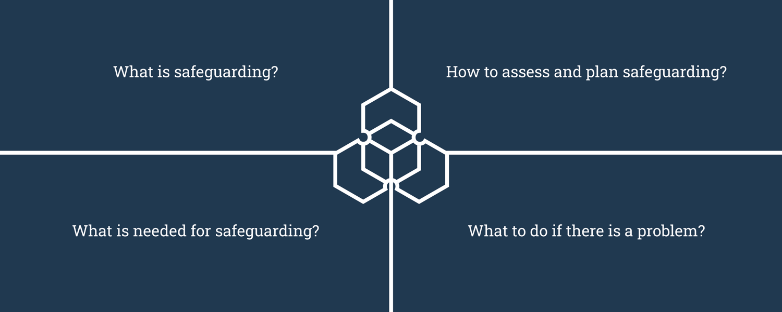
This presentation will cover:

Slide 3
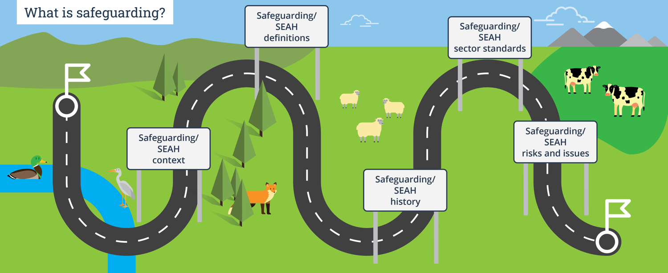
Part one of the journey…

Slide 4
1. What is safeguarding?
In an organisation, certain people sometimes have more power based on their gender, race, role in the organisation, disability, sexuality, nationality, employment status, or education. People with less power can be at greater risk of exploitation and abuse.
Sexual exploitation, abuse and sexual harassment (SEAH) involves people within organisations using their power in harmful ways against people who are less powerful, either in the organisation, in partner organisations or in the communities where the organisation works. Powerful people can also perpetrate physical and emotional violence. We refer to these other forms of violence as safeguarding violations.
SEAH impacts women and girls in particular, but it can also affect men and boys.
Safeguarding addresses the misuse of power

Slide 5


1. What is safeguarding?
Safeguarding means an organisation is taking actions to:
Keep people safe from sexual exploitation, abuse, sexual harassment, and other forms of harm caused by the misuse of power.
Address harm caused by the organisation’s staff, associates, operations or programmes that may be unintentional.
Safeguarding focuses on preventing and addressing harm caused by the organisation. Protection programming is different: it focuses on preventing harm caused by people within families and communities.
5 | The Safeguarding Journey

Slide 6
Recent history of safeguarding
There have been many reports of sexual abuse and exploitation by people working in the aid and development sector over the past decades.
In 2002, a report described sexual abuse and exploitation of refugees by aid workers in West Africa. This led to the development of the UN Special Measures for the Protection from Sexual Exploitation and Abuse (PSEA), the UN Interagency Standing Committee PSEA Task force, and the Keeping Children Safe Coalition.
In 2018, many organisations began to review their safeguarding policies, practice, culture and leadership after reports of sexual exploitation and misconduct in the development sector. At the same time, the #metoo movement was highlighting women’s experiences of sexual exploitation, abuse and harassment.
Since then organisations have particularly increased their focus on listening to survivors.

Slide 7
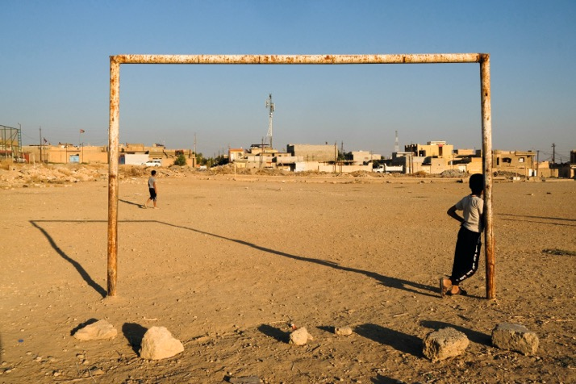
Where does Sexual Exploitation, Abuse and Sexual Harassment (SEAH) and other safeguarding issues happen?
SEAH and other safeguarding issues can happen in any workplace or aid programme.
High risk contexts include:
Where there is extreme poverty
Humanitarian contexts
Where there is a high dependence on aid
Where there are protection issues such as early marriage or gender-based violence.
Photo by Vincent Haiges
Organisations must assess the contexts in which they work, and listen to the people they work with about existing protection issues and who might be most at risk. Organisations can then plan safeguarding actions.

Slide 8
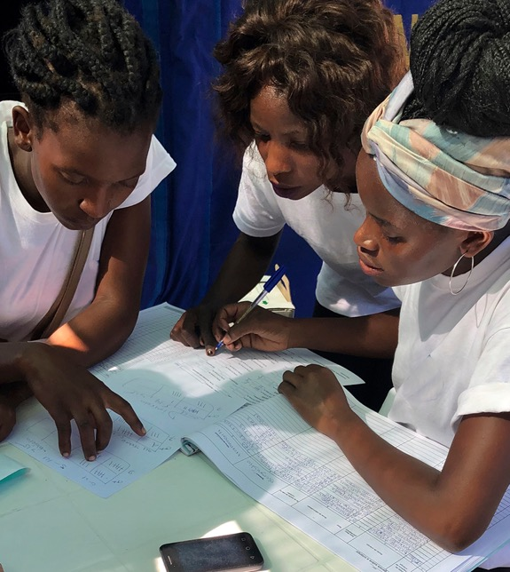
Sector standards
    Several sets of safeguarding standards apply to the aid and development sector.
    They define and describe what is required for an organisation to work safely.
    They help organisations deliver good quality programmes that are accountable to communities.
    Donors often require organisations to meet certain standards and strengthen their capacity in order to qualify for funding.

Slide 9
Global sector standards
    DAC Recommendation on Ending Sexual Exploitation, Abuse, and Harassment in Development Co-operation and Humanitarian Assistance
    The Interagency Standing Committee Minimum Operating Standards for Protection from Sexual Exploitation and Abuse (PSEA) by own Personnel
    Core Humanitarian Standard on Quality and Accountability
    Keeping Children Safe Standards
    International Labour Organization Convention on Violence and Harassment in the Workplace

Slide 10
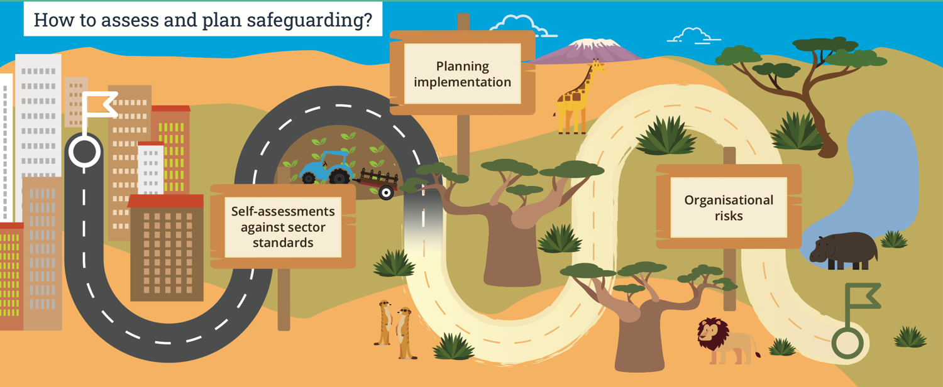
Part two of the journey…

Slide 11


2. How to assess safeguarding
Self assessment tools help organisations identify which international safeguarding standards they currently meet and which ones they do not meet.
It is useful to conduct self assessments regularly to monitor and measure progress on safeguarding and to update plans.
Examples of tools include Core Humanitarian Standard Alliance tools and the Keeping Children Safe self-audit tool.
11 | The Safeguarding Journey

Slide 12



2. How to plan safeguarding
Organisations benefit from an organisation-wide safeguarding plan to continuously improve and maintain safeguarding measures.
Some organisations plan to meet international standards, others plan according to specific risks in different departments, teams, or locations.
It is important to clearly budget for safeguarding plans.

Slide 13
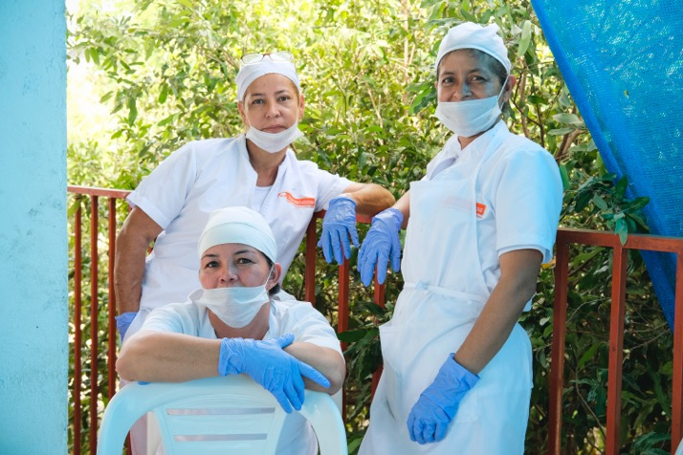
Organisational safeguarding risks
Organisational risks related to safeguarding and sexual exploitation, abuse and sexual harassment (SEAH) can depend on how an organisation is structured, its programme focus and way of operating.
For example, organisational risks may come from:
Working in a community where staff live, or where staff have relationships with other community members outside of their work.
Needing to quickly recruit and train large numbers of staff and volunteers in emergencies.
Photo by Sebastian Delgado

Slide 14


Organisational safeguarding risks
Organisations need to identify and manage sexual exploitation, abuse and harassment (SEAH) risks across all parts of the organisation.
Organisations can use existing tools and approaches to conduct risk assessments and manage SEAH risks.
Organisations often keep a list of major SEAH risks and actions to address them in a risk register that is regularly monitored by the Board of Directors, Board of Trustees, or other management and governance structures.

Slide 15
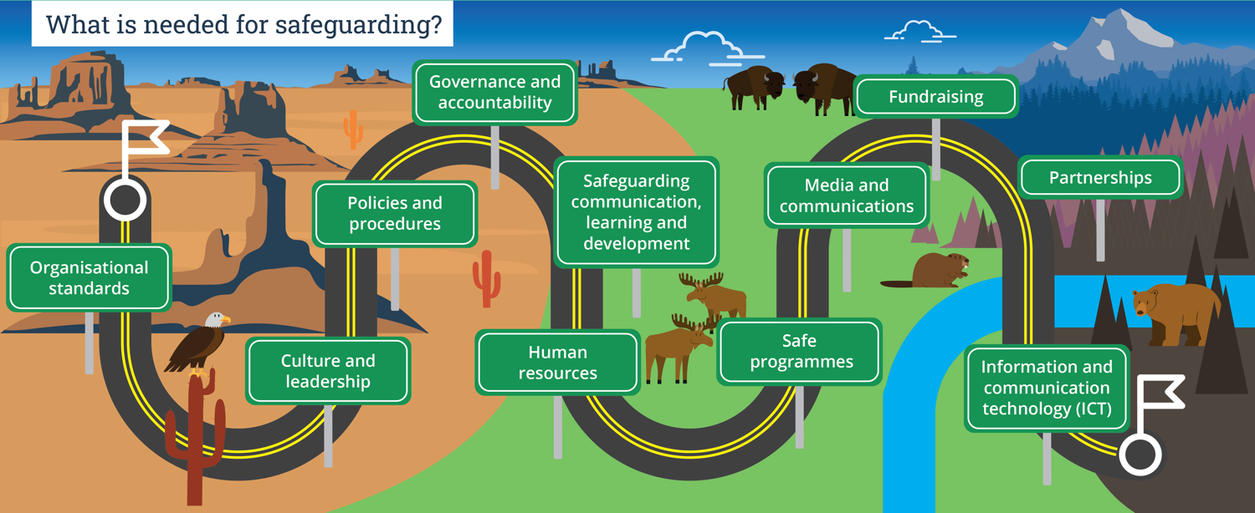
Part three of the journey…

Slide 16



3. What is needed for safeguarding?
Organisational standards
    Organisations often develop their own organisational safeguarding standards for all of the different business areas, e.g. human resources, programmes, partnerships.
    Organisational standards should align with international standards set by the aid and development sector.
    They can be used for planning, implementation, monitoring and review. They also show donors that the organisation is actively managing safeguarding.

Slide 17
3. What is needed for safeguarding?
Organisational culture and leadership
    Policies and procedures are important, but they are not enough to create safe organisations. An organisation’s culture and leadership is essential for effective safeguarding.
    Organisations need to understand where power lies in their organisation and how power impacts positively or negatively on the organisation’s culture.
    Organisations can change their culture through leadership approaches. When leaders show respect and accountability in their relationships with others, they build safer and more effective organisations.
    Tools for organisational culture change include organisational culture reporting, guidance on organisational change, and leadership competencies and charters for safeguarding.

Slide 18
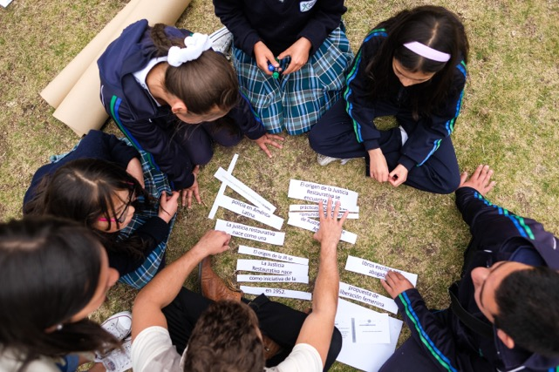
3. What is needed for safeguarding?
Safeguarding policies
A safeguarding policy explains an organisation’s commitments to preventing and responding to sexual exploitation, abuse, sexual harassment (SEAH), and other forms of harm. It could be a short document stating commitments and principles.
Photo by Sebastian Delgado
18 | The Safeguarding Journey

Slide 19
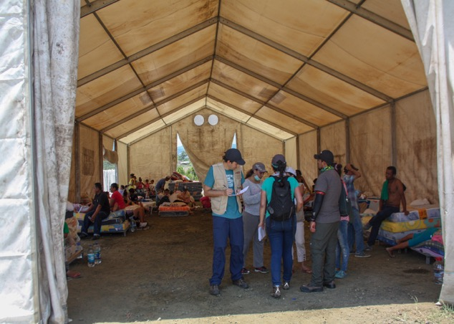
3. What is needed for safeguarding?
Safeguarding procedures and Codes of Conduct
    Safeguarding procedures explain in detail how safeguarding commitments will be put in to practice in the organisation’s programmes and operations. The procedures could be built into existing procedures such as for recruitment, or the organisation could make new systems and processes, such as procedures for reporting sexual exploitation, abuse and harassment (SEAH).
    Organisational Codes of Conduct explain the expected behaviours of staff and associates. They could be a separate document, covering all types of professional conduct, or they could be written in to a safeguarding policy.
Photo by Santiago Rodriguez
19 | The Safeguarding Journey

Slide 20




3. What is needed for safeguarding?
Governance and accountability
    Organisations need to have clear ways of governing safeguarding and holding the organisation accountable for safeguarding.
    Regular management reporting on safeguarding performance, and Trustees reviewing this performance, is essential for accountability.
    Executive teams and Boards of Trustees that have specific governance and accountability roles for safeguarding can help the organisation meet its policies, monitor risks, and learn from successes or safeguarding cases. Having safeguarding focal points in each department or team can also be helpful.
    Accountability can be strengthened by the executive and board levels hearing from a range of different people, including survivors of sexual exploitation, abuse and sexual harassment (SEAH).
20 |

Slide 21
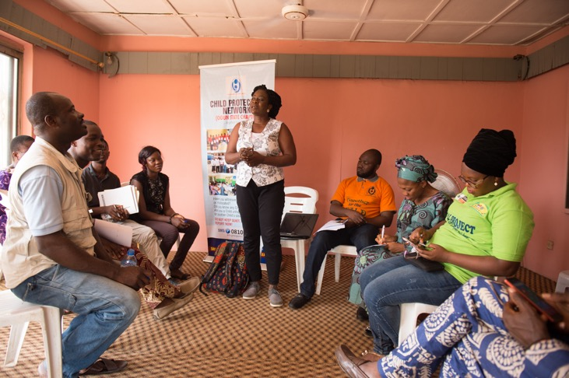
3. What is needed for safeguarding?
Communication, learning and development
All staff and associates need to understand their safeguarding responsibilities and how to fulfil these.
This requires effective communication on safeguarding and regular training for staff and associates.
Photo by Paul Robin
Some people need more training. For example safeguarding focal points, human resources staff and leadership teams need more specific knowledge and additional training on their safeguarding duties.
21 | The Safeguarding Journey

Slide 22
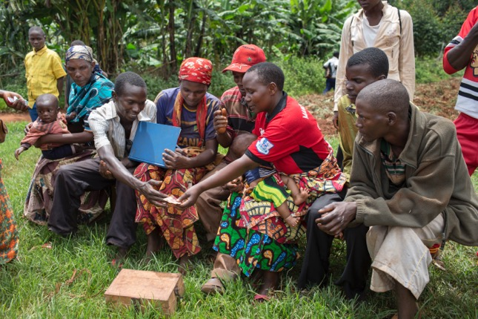
3. What is needed for safeguarding?
Communication with communities
    All programme participants, their communities and the wider population, including children, need to know about the organisation’s safeguarding commitments.
    People, including children, have different needs, abilities and levels of understanding. It is helpful to use many different ways of communicating so that many different people can understand information on safeguarding and their rights to protection from sexual exploitation, abuse and harassment (SEAH).
Photo by Will Baxter
22 | The Safeguarding Journey

Slide 23


3. What is needed for safeguarding?
Human resources
    Organisations need to practice safeguarding before, during, and after a staff member or associate works with the organisation.
    During recruitment, the organisation needs to assess any safeguarding risks that a staff member or associate might pose, for example by conducting referee checks to identify if an applicant has breached a policy or code of conduct in the past, and by asking interview questions about the applicant’s behaviour and their understanding of safeguarding.
    During the staff member or associate’s work, the organisation needs to ensure that they are aware of, understand, and abide by safeguarding policies and codes of conduct.
    The organisation needs to have procedures in place to respond to incidents if a staff member or associate breaches the Safeguarding Policy and Code of Conduct, including investigation procedures and disciplinary procedures.
    If a staff member or associate leaves the organisation or is dismissed, the organisation can use the Inter-Agency Misconduct Disclosure Scheme to share information about misconduct, and keep records of disciplinary measures on staff, including dismissals, to prevent re-hiring them in future.
23 | The Safeguarding Journey

Slide 24
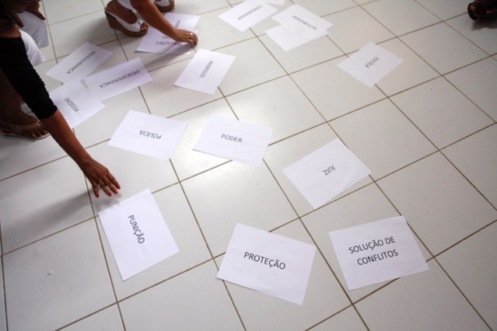
3. What is needed for safeguarding?
Safe programmes
    Safeguarding concerns are more common in poorly designed programmes, or when programme staff have not carefully considered safeguarding risks in programmes.
Organisations need to think about safeguarding during the design, delivery and evaluation of programmes, events and activities. E.g. the Sphere Handbook, the Minimum Standards for Child Protection in Humanitarian Action, and an organisation’s own guidance tools help to clarify what is needed to design and deliver safe programmes in different sectors.
Photo by Odile Meylan

Slide 25



3. What is needed for safeguarding?
Media and communications
    The publication of images and stories of programme participants are an important part of any organisation’s work, but these communications must not create possible or actual risks to the people they feature, and communications must respect their privacy and dignity.
    All communications material should be collected, developed, stored, distributed and published in a way that is safe and with consent from the people they feature.
    Organisations also need clear guidance on using social media and online platforms to help address safeguarding risks.

Slide 26
3. What is needed for safeguarding?
Fundraising
    Organisations are usually required to show that they meet donor safeguarding standards.
    Organisations can help themselves to meet donor safeguarding standards by budgeting for safeguarding activities as core or programme costs in funding proposals.

Slide 27

3. What is needed for safeguarding?
Partnerships
    Working in partnerships has many benefits, but also involves safeguarding risks. Donors expect both your organisation and your partners to meet their standards.
    It is important to review potential partners’ safeguarding arrangements and clearly communicate the standards they must meet.
    Clarify how the partnership arrangements will include safeguarding. Contracts and partnership agreements should include safeguarding arrangements and expectations. Often partnership agreements need to include how partners will support each other to strengthen safeguarding. Larger organisations may need to support the capacity of smaller partners.
    Safeguarding should also be part of monitoring and reporting arrangements between partners.

Slide 28



3. What is needed for safeguarding?
Information and communication technology (ICT)
    Organisations benefit from an Information and Communication Technology (ICT) policy that includes guidance on how to safely use ICT.
    An organisation should not use its ICT to access or exchange illegal or inappropriate content, including sexual content.
    The ICT team can also create systems or processes that help organisations to securely store and process large amounts of information about staff and the people that the organisation works with. This should be in line with relevant data protection legislation.

Slide 29
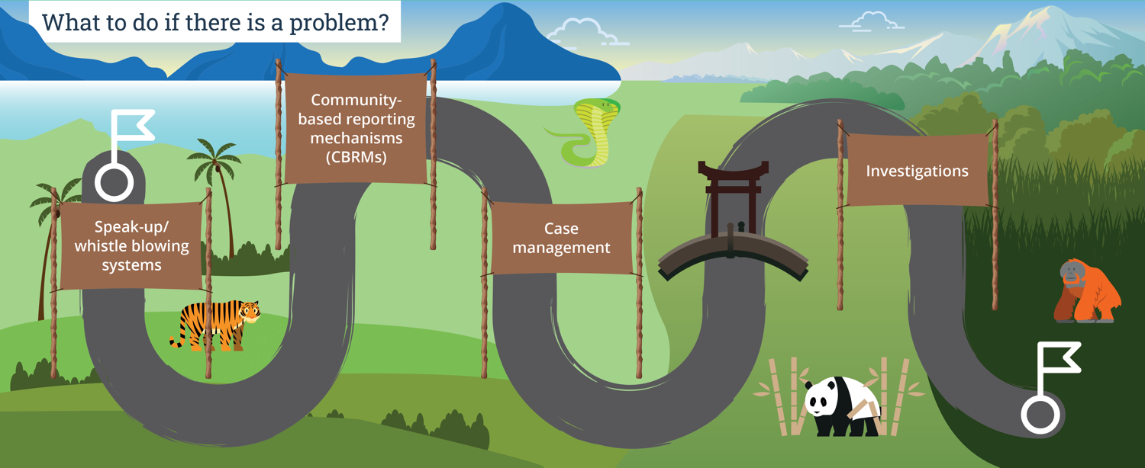
Part four of the journey…

Slide 30

4. What to do if there is a problem
Speak-up/whistle-blowing systems
    A speak-up or whistle-blower system helps staff to report concerns about safeguarding, sexual exploitation, abuse, sexual harassment, and other forms of harm.
    These systems need to be accessible to everyone and work for everyone. They should prioritise the survivor’s rights, needs and wishes.
    All staff and associates must be confident that the system will support and protect them when they report a concern. The system should offer protection from complaints that try to cause harm to staff or associates.
    The most effective systems are developed together with staff, to help recognise and address any barriers to reporting that a survivor may experience because of their gender, disability, race, age or other identities.

Slide 31
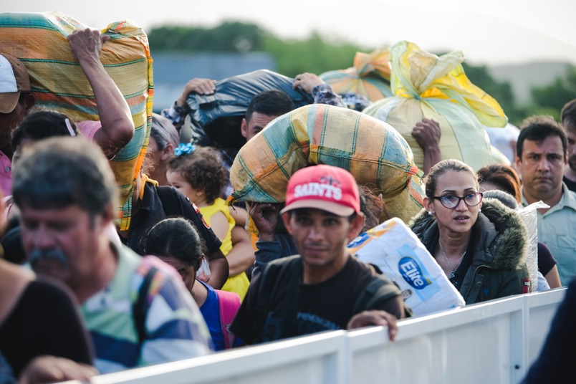
4. What to do if there is a problem
Community-based reporting mechanisms (CBRMs)
    Every person who the organisation works with must have a way to report safeguarding, sexual exploitation, abuse, and sexual harassment concerns.
    Community-based reporting systems must prioritise the survivor’s rights, needs and wishes.
Photo by Sebastian Delgado

Slide 32
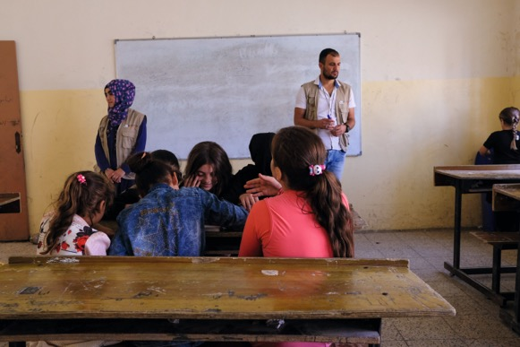
4. What to do if there is a problem
Community-based reporting mechanisms (CBRMs)
    The most effective systems are developed together with community members. This helps to recognise and address any barriers to reporting that a survivor may experience because of their gender, disability, race, age or other identities.
    The most effective systems provide a range of different ways to raise concerns or report harm. Many organisations include these systems in their wider feedback and complaints mechanisms.
Photo by Vincent Haiges

Slide 33

4. What to do if there is a problem
Case management
    Case management is the process an organisation uses to receive and respond to concerns about safeguarding and sexual exploitation, abuse and sexual harassment.
    The safety and protection of everyone involved in safeguarding cases is extremely important.
    The survivor’s rights, needs, and wishes must be prioritised in case management, and everyone involved in the case must be treated with dignity and respect.

Slide 34



4. What to do if there is a problem
Case management procedures
    Case management procedures ensure that everyone understands how to deal with safeguarding incidents and allegations. These procedures should include information on how to refer a case to national authorities for criminal prosecution when there is evidence to support allegations of sexual exploitation, abuse or sexual harassment (SEAH).
    The procedures should also include information on how to refer survivors of SEAH to quality services. For example, a survivor may need medical, legal or other services, but the survivor’s information should only be shared if they want to access the services and they have given consent.
    Procedures must be based on the local legal and social welfare context.

Slide 35


4. What to do if there is a problem
Investigations
    Investigations of safeguarding cases within an organisation focus on how the organisation’s policy or code of conduct may have been breached. They are not criminal investigations.
    Investigations must be detailed, confidential, impartial, objective, and timely, and this requires particular training, skills and expertise.
    Organisations benefit from detailed investigation guidelines.
    Where organisations don’t have the skills and expertise to conduct investigations themselves, they can use external specialist investigation services.
    When there is evidence to support an allegation that may breach the law, organisations may also need to refer the case to authorities for criminal investigation, based on the organisation’s case management procedures.

Slide 36
Key things to remember along the Safeguarding Journey
Safeguarding is about keeping people safe from and addressing harm that has been caused by the organisation’s staff and/or associates misusing their power.
Sexual exploitation, abuse and harassment can happen in any organisation, anywhere.
Organisations need to understand where power lies in their organisation and leaders need to create a culture of respect and accountability.
Organisations need to regularly assess themselves against safeguarding standards, assess safeguarding risks, and create and monitor organisation-wide safeguarding plans.
Organisations need to address safeguarding across the whole organisation, through safeguarding standards, policies and procedures, governance and accountability mechanisms, communications, learning and development, human resources departments, programming approaches, media and communications, fundraising, partnerships, and ICT.
To address safeguarding incidents, organisations need accessible systems that all staff, associates and people in communities can access. Organisations need clear case management procedures and investigations.

Slide 37
  For more support, tools and resources on safeguarding, visit the RSH website: safeguardingsupporthub.org
This document is an output from the Safeguarding Resource and Support Hub programme funded by UK aid from the UK government. However, the views expressed, and information contained in it are not necessarily those of or endorsed by the UK government, who can accept no responsibility for such views or information or for any reliance placed on them.
This publication has been prepared by the programme, its consortium members and the wider academic and practitioner community for general guidance on matter of interest. For any further information or enquiry, contact veronica@rshub.org.uk

