Slide 1
Information Security & Privacy

Slide 2
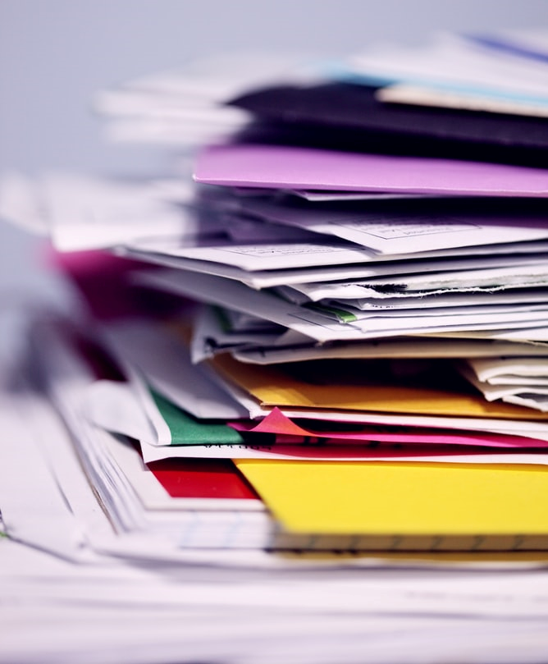
Sensitive Information
Staff personnel files
Beneficiary details
Financial information
Staff travel plans
Security procures and plans
Security and political analysis
Records of engagement with authorities, security forces, armed groups, or political figures
Security incident reports
Be mindful of the information and data you collate, how it’s stored and communicated to others, and who has access to it.

Slide 3
Securing Information
Physical Security: physical controls and barriers that restrict unauthorised access.
Digital Security: systems and procedures to protect the collection, storage and disposal of digital information.
Communications Security: tools, platforms and procedures to share information securely.
Information Security
Physical Security
Digital Security
Communications Security

Slide 4
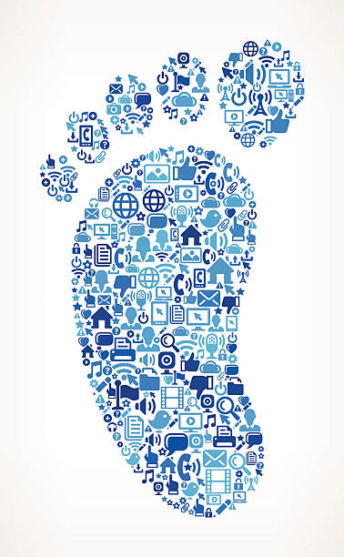
Digital Footprint
Every day, whether we want to or not, many of us add to a growing online footprint of who we are:
Digital traces of our online activity and personal data.
Information we share through social media platforms.
With greater online presence comes increased risk as this information, in the wrong hands, can be used against us.

Slide 5
Using Social Media
Inappropriate comments or posts could place yourself or others at risk.
Think before posting
Understand the context
Security first!
Speak for yourself
Always be respectful
Don’t disclose sensitive information
If unsure, seek advice

