Slide 1
Managing Travel & Movements

Slide 2
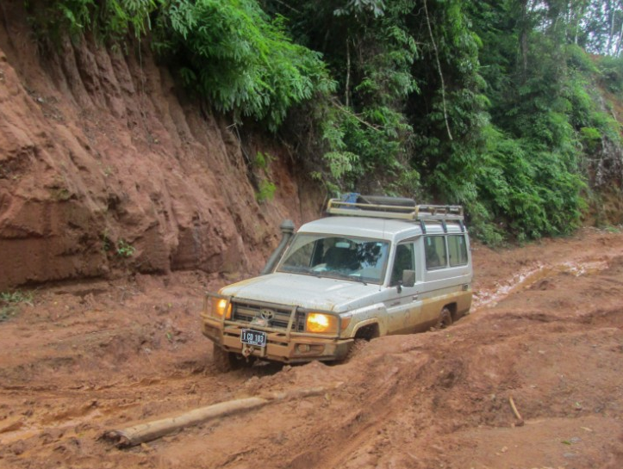
Travel & Movements
Most security and safety incidents affecting aid workers occur while travelling in project areas.
The establishment of, and adherence to, effective travel and movement procedures is essential to minimise risks associated with staff travel.

Slide 3
Modes of Travel

Slide 4
Field Mission Exercise
In groups, plan a trip to Location X for programme staff to undertake a needs assessment.
The team will be departing from Location Y and should return by the end of the day.
Identify the routes, potential challenges and risk, essential pre-travel requirements and other key considerations for the trip.

Slide 5
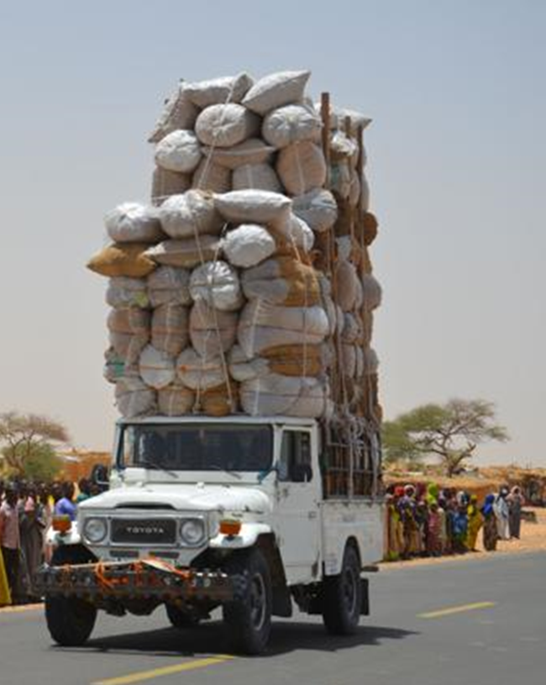
Staff Travel Planning
Risks
Team profiles
Routes & travel times
Authorisation
Vehicles/Transport
Documentation
Equipment
Visibility
Movement tracking
Communications
Confidentiality
Contingencies

Slide 6
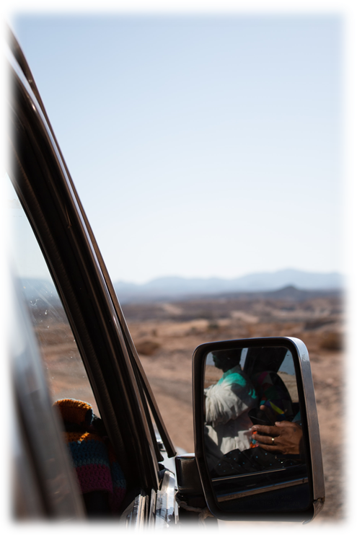
Movement Monitoring
It is essential to monitor staff and vehicle movements, especially if travel is in areas with increased risk.
Movement control systems range from satellite tracking to a simple movements board - it doesn’t need to be too complicated!
Need to track who (staff & vehicles) is going where, when and ETA/ETR.
Information should be stored centrally and easily accessible.
Maintain regular communication for the duration of the trip to confirm safe arrival at destination and/or home base.
All travelling staff or vehicles should have access to reliable means to contact either their base, or others in the event of an emergency.

Slide 7
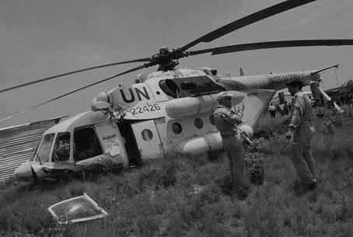
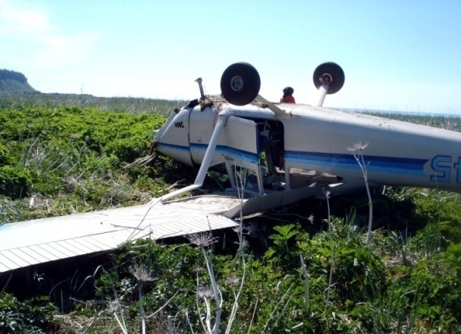
Air Safety
Air travel is generally safe, but risks can increase due to weather conditions, terrain, limited infrastructure, and poor safety standards.
In some locations the choice of carriers that fly to the airports required by staff is limited.
Helicopters are often used in relief operations to reach inaccessible areas. However, travelling by helicopter poses an additional safety hazard.

Slide 8
Air Safety – Basic Precautions
Assess the risks - check the safety records of airlines both nationally, and to and from the country, and issue appropriate guidance to staff.
Balance the risks - consider the frequency of use, the reasons for travel, and the practicality, costs and risks associated with other modes of transport.
Use larger aircraft - adhere to stricter safety regulations and manufacturing standards.
Use more direct routes - most accidents occur during take off and landing.
Watch the weather - ensure trips are planned to avoid bad weather.
Advise staff not to board a flight if concerned - too many passengers/seats; clearly overloaded; baggage/freight in the aisle; poor security screening.
Encourage staff to report incidents or safety concerns.

Slide 9
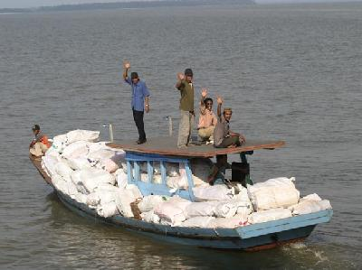
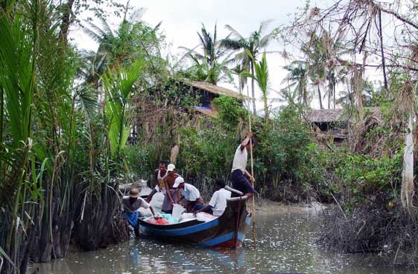
Boat Safety
Use of boats and other watercraft as part of programme delivery is common following flooding or other natural disasters, or when staff are working in coastal areas or locations only accessible by water.
Types of boats used range from canoes, inflatables and RIBS to large vessels.
For some staff this may be an unfamiliar operating environment and can pose significant safety risks.
Many of these risks can be minimised by using basic safety equipment and following safe water practices.

Slide 10
Boat Safety – Basic Precautions
Make sure the boat is suitable - in good condition and regularly maintained.
Know its operating limits - check certificates for seagoing vessels.
Make sure suitable safety equipment is on board - life jackets, fire extinguishers, comms equipment, flares, spare fuel, first-aid kits, etc.
Treat boat travel the same as vehicle travel - control it by a movement board and regular radio checks.
Watch the weather - ensure trips are planned to avoid bad weather.
Don’t overload - more weight, the less responsive to sea conditions.
Have contingency plans in place - for breakdowns, weather problems or loss of contact.
Ensure staff always wear a lifejacket!

