Slide 1
Security Funding

Slide 2
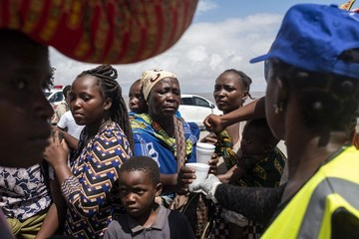
Resourcing Security
Keeping staff safe has resource implications. Security and safety costs must be adequately addressed in proposals and annual budget plans.

Slide 3
Limited Resources
Limited funds allocated to staff security and safety.
Security costs not routinely addressed in proposals.
Widespread perception among staff that donors are unwilling to fund security.
Pressure to reduce overall budget - security expenditure often an easy target.
Limited tracking of security expenditure, no appreciation of the actual cost of security.

Slide 4
Security Costs
Assessments - security assessments in new geographic regions, security review/audits.
Personnel - security staff (Security Manger/Security Focal Points) guards, radio operators.
Equipment - communication equipment (satellite phones, HF and VHF radios), first aid kits, fire extinguishers, equipment for guards, vehicle tracking equipment, etc.
Information - security analysis and travel risk information subscriptions.
Training - drivers (safe driving & comms training), guards (security guard training), SOs/SFPs (security management training), programme staff (personal security training, first aid).
Facility upgrades - improving compound walls, installing barriers, alarm systems and CCTV, strengthening doors and windows, improving lighting, and creating secure rooms, etc.
Travel costs - field travel budget to undertake trainings/conduct assessments/reviews.

Slide 5
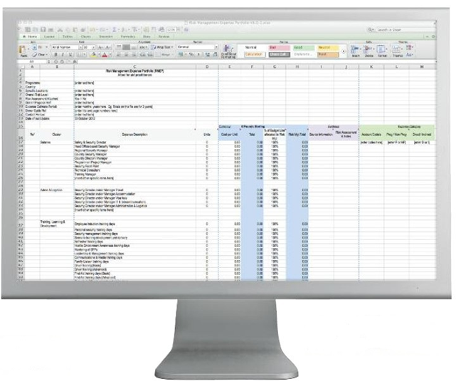
Security & Proposals
Security should not be part of overhead costs or arbitrary percentage of the programme budget.
Needs to be identify as direct expenditure.
Proposals budgets should include a separate line for security and safety costs.
Need to be able to justify security expenditure – security assessment and risk analysis included in the proposal.
Provide costings and guidance to programme staff.
Ensure security expenditure is tracked to enable better monitoring of security costs.
Download the RMEP
tool from www.gisf.ngo

