Slide 1
Contingency Planning

Slide 2
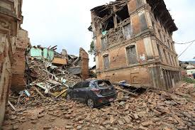
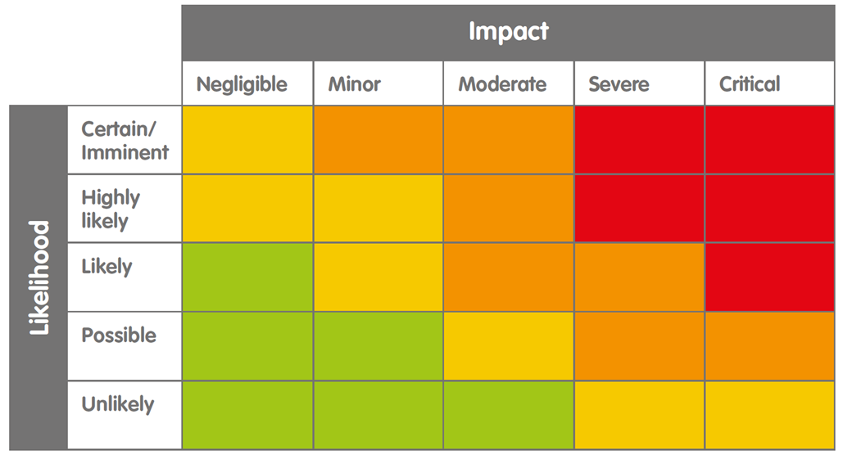
Contingency Plans
Contingency plans are developed for foreseeable high-risk incidents/situations:
which are most likely to happen & will have significant impact on staff and operations.
which require a lot of information & preparation in order to respond.
which require a quick coordinated response from different stakeholders.
Plans for the relocation or evacuation of staff, natural disasters, and medical emergencies.
Contingency plans help to reduce the impact of threats should they occur.
Reduce Impact

Slide 3
Key Planning Questions
What could happen?
Who could be affected?
What is needed to respond?
Who needs to be informed?
Who needs to make what decisions?
What can be done to be better prepared?

Slide 4
Hibernation, Relocation & Evacuation
Hibernation/Suspension - temporarily halting activities. Staff remain at home or other safe location to avoid an emerging threat, or until conditions improve.
Relocation - withdrawing staff and assets to a safer area within the country, until the situation stabilises.
Evacuation - withdrawing staff to a place of safety across the international borders of the country, or to their home country.

Slide 5
When to Withdraw
The need to hibernate, relocate or evacuate staff may be triggered by:
Serious deterioration in overall security situation, or the outbreak of violent unrest/conflict.
Natural disaster or hazard, or health crisis that poses a significant threat to the health and safety of staff.
A significant, and credible, threat to aid agencies, or to the organisation's staff directly.
Authorities or embassies advise staff to leave.
Security and safety concerns outweigh the benefits of a particular programme or make it impossible to meet programme objectives.

Slide 6
Security Levels
Situation Normal
No major security concerns.
No limitations to operations. Basic personal security precautions.
Heightened Tensions
Minor security concerns.
Increased security awareness. Routine security procedures.
Restricted Movements
Access to beneficiaries limited. Increased risk to staff.
Restrict movements. Relocation/hibernation preparedness.
Relocation or Hibernation
Conditions do not allow work. Significant risk to staff.
Temporary relocation or hibernation of staff.
Suspension of Activities or Closure
Unacceptable level of risk to staff.
All activities suspended. Closure of office.
1
Security levels or phases are specific to each organisation, reflecting its programme activities, security management capacity and resources, and its risk tolerance.
2
3
4
5

Slide 7
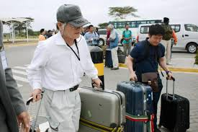
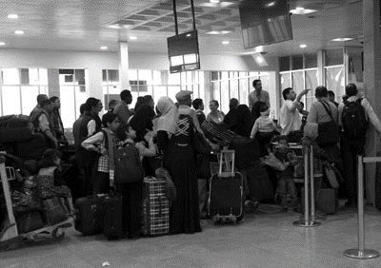
Who to Withdraw
International staff (essential vs non-essential staff)
Consultants
Dependents
Relocated national staff
Others?

Slide 8
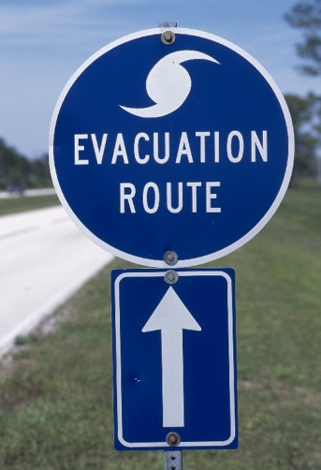
Basic Preparations
Criteria - clarify who is to be relocated or evacuated, and the support provided to those remain.
Roles & Responsibilities - specify the decision-makers, and identify roles and responsibilities of different team members.
Staff Lists - track where staff are located to plan transport requirements.
Routes & Transport - provide information on routes and options. Always consider alternatives!
Assembly Points - inform staff where to assemble in preparation for relocation or evacuation.
Hibernation - identify safe areas for each location.

Slide 9
Basic Preparations
Communication - outline how to notify staff of an imminent withdrawal and activate the ‘Communication Tree’.
Admin & Finance - specify any administrative and financial requirements (travel documents, salary advances).
Information Security - outline procedures for safeguarding sensitive documents and files.
Equipment & Supplies - include details of emergency supplies required for each location, and how to secure critical assets.
Checklists - include easy-to-read checklists and other resources to assist staff in undertaking key tasks (emergency contact details and ‘grab bag’ lists).

Slide 10
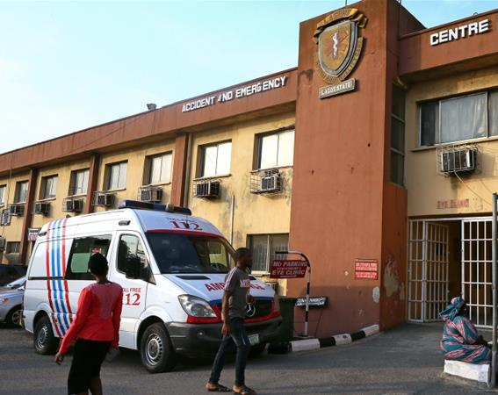
Medical Emergencies
In the event of serious injury or illness, staff may need immediate medical or hospital treatment.
Preparedness and rapid response is vital in any medical emergency.
All staff must know how and where to get the best medical attention in a particular location.
Need to identify the medical assistance available locally and assess its capacity to respond.
If local medical assistance is unavailable or inadequate, evacuation to a reliable medical facility in-country, or in another country, may be necessary.

Slide 11
Basic Preparations
Responsibilities - determine responsibilities for staff health and medical assistance support within the Country Office and the different field offices.
Key Contacts - identify the emergency contacts for local health facilities, insurance company and medical assistance provider.
Reporting Procedures - clarify the reporting procedures for staff illness and injury, who must be informed, and the reporting process and forms that should be completed.
Medical Insurance - provide details on medical insurance in place, clarify which staff it applies to, and what is covered.
Healthcare Facilities - list and prioritise approved local healthcare facilities and hospitals that staff should use, identify any limitations.
Medical Evacuations - provide details of medical evacuation procedures, key contacts, the authorisation process and essential information required.

Slide 12
Medical Evacuations
Accessibility & Transport - identify nearest access points, transport options (road and air ambulances) and any limitations (night movements/fuel).
Permissions - determine travel or flight clearance requirements and any potential issues or delays.
Escorts - identify who will accompany the patient if required.
Documentation - determine any documentation requirements (passport/ID documents, visas, medical assessments, insurance details, etc).
Initial Report - immediately inform Country and HQ-level staff health/HR contacts.
Essential Information - person reporting incident, the patient, their location, nature of their injury/illness, medical care provided and current condition, and nearest air access point.
Medical Assistance Provider - register case with assistance company (if available), determine level of support they can provide.
Emergency Contacts - establish staff member’s emergency contacts and identify who will contact family.

