Slide 1

Managing Site Security

Slide 2
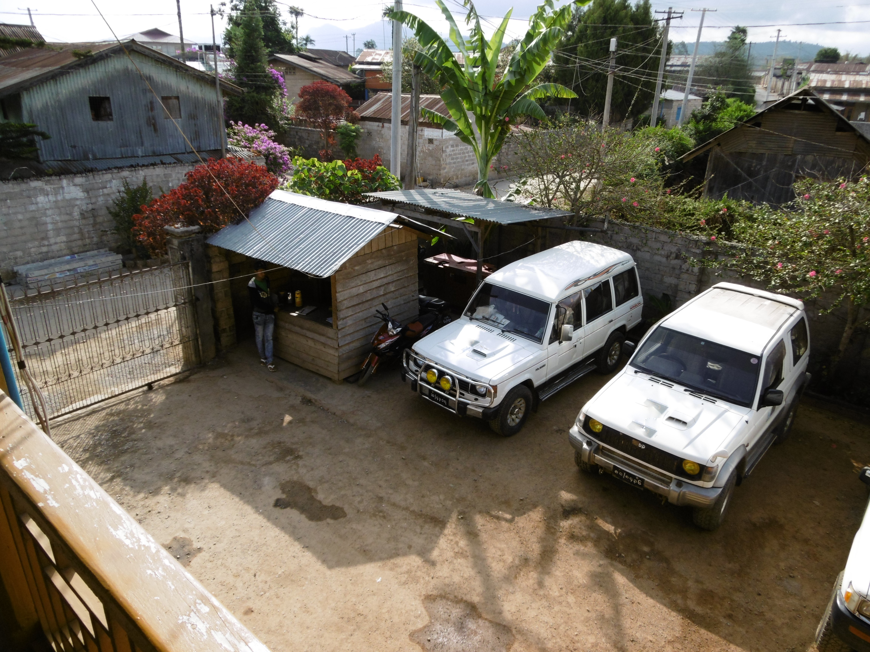
Site Security
Staff should feel safe and secure while at work, or in their residence or guesthouse.
Facilities must be located in areas that ensure a reasonable level of security and safety for staff, and appropriate measures and procedures be in place to prevent or deter threats that exist in that location.

Slide 3
Site Selection
Location:
Threats - robberies, IEDs, violence/unrest, natural hazards.
Neighbourhood - surrounding properties, potential targets, any associations with a particular group/individuals, level of acceptance of NGOs in the area.
Security - local security provision & measures used by others in the area.
Accessibility - access to main roads & key facilities (airports etc), could staff easily evacuate the area in an emergency.
Building:
Building type - advantages & disadvantages, level of control, safety concerns.
Structures - physical condition, vulnerability to potential hazards.
Perimeter - defined boundaries, walls or fences.
Access - control measures, multi-tenancy.
Security - condition of doors, gates & windows.
Lighting - access points & street areas.
Safety – essential services (electrics, gas & water), ability to evacuate building.
Parking - within a compound or on the street.

Slide 4


Site Protection Measures
Achieved through a combination of ‘layers’, both:
PHYSICAL PROCEDURAL
walls, gates, lighting, bars on windows, locked doors, emergency exits, shelters & barriers, secure rooms, smoke detectors, fire extinguishers, alarms, CCTV, identification etc.
guards, key control, checking windows and doors, displaying ID cards, visitor & vehicle checks, waiting area, parking area, accompanying visitors, evacuation routes etc.

Slide 5
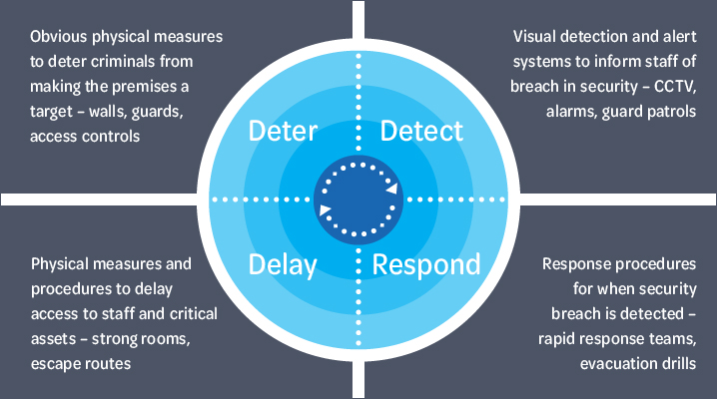
Deter – Detect – Delay – Respond

Slide 6
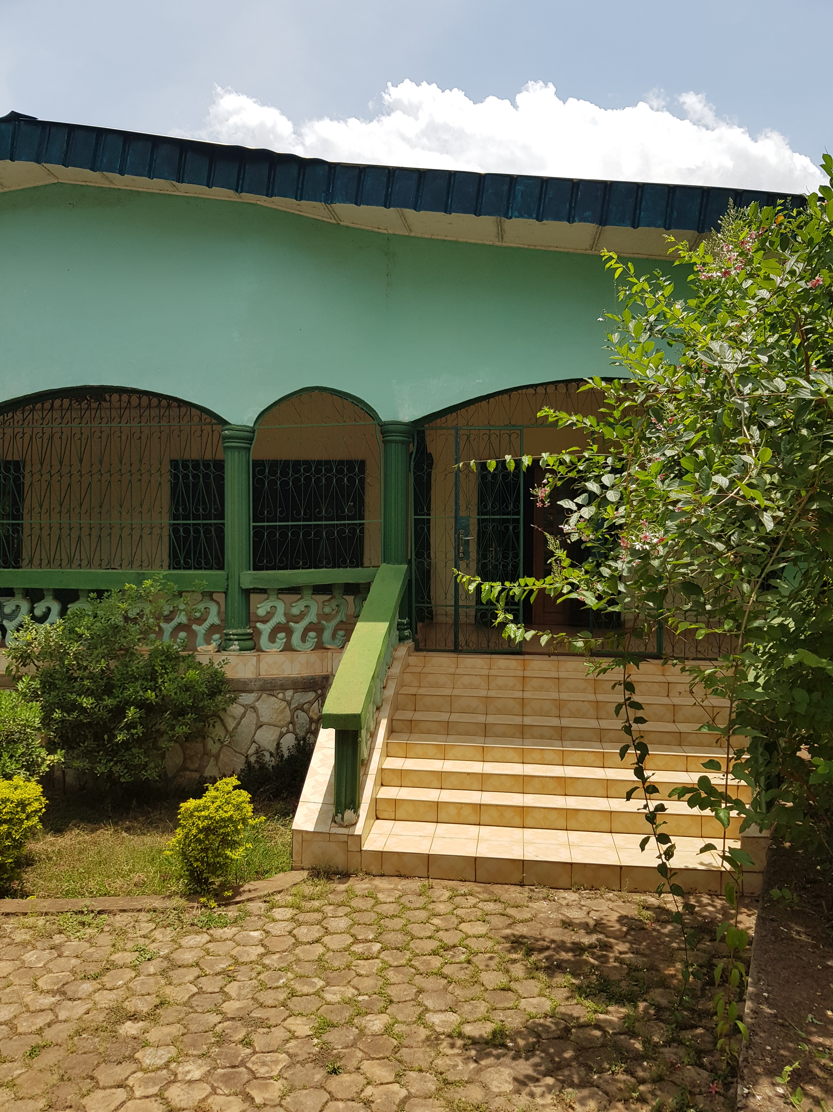
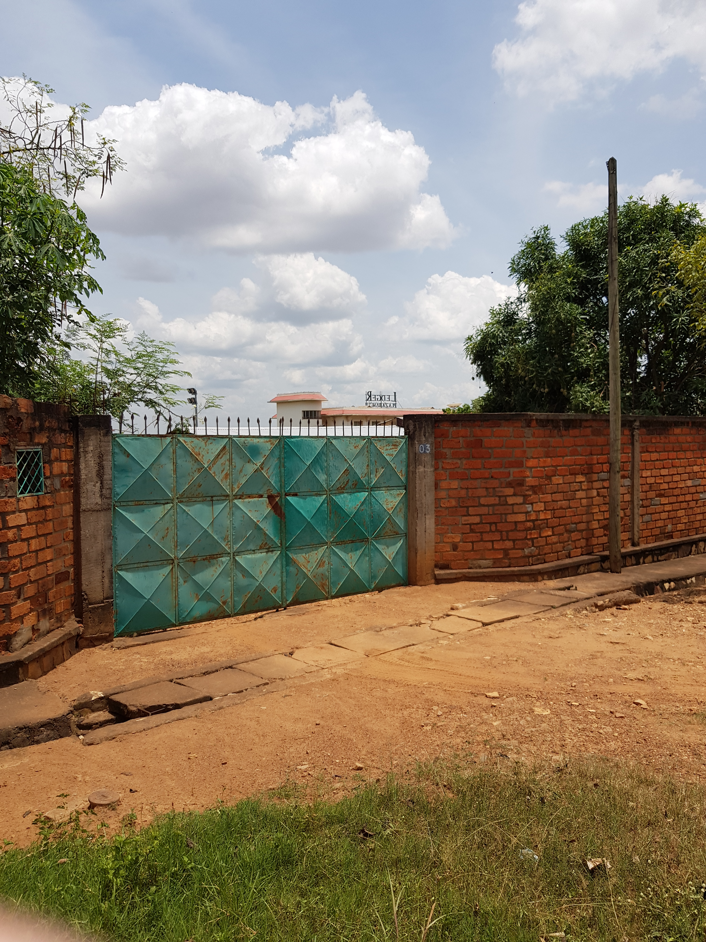
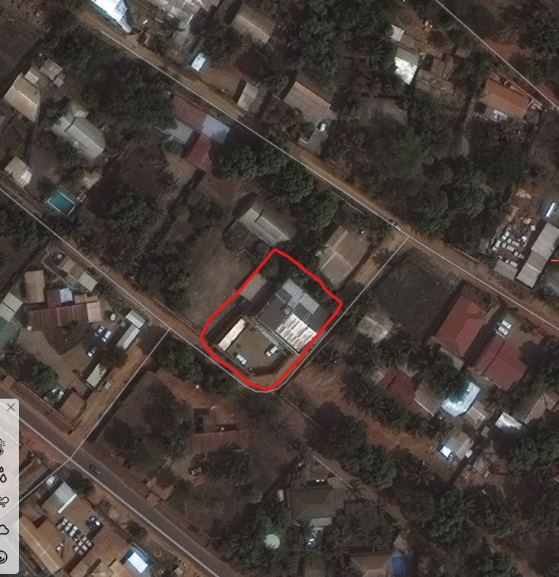
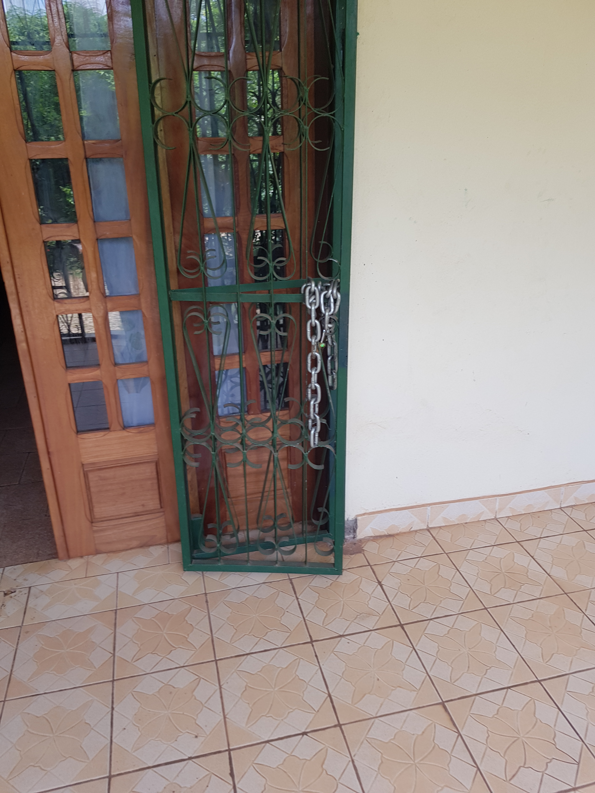
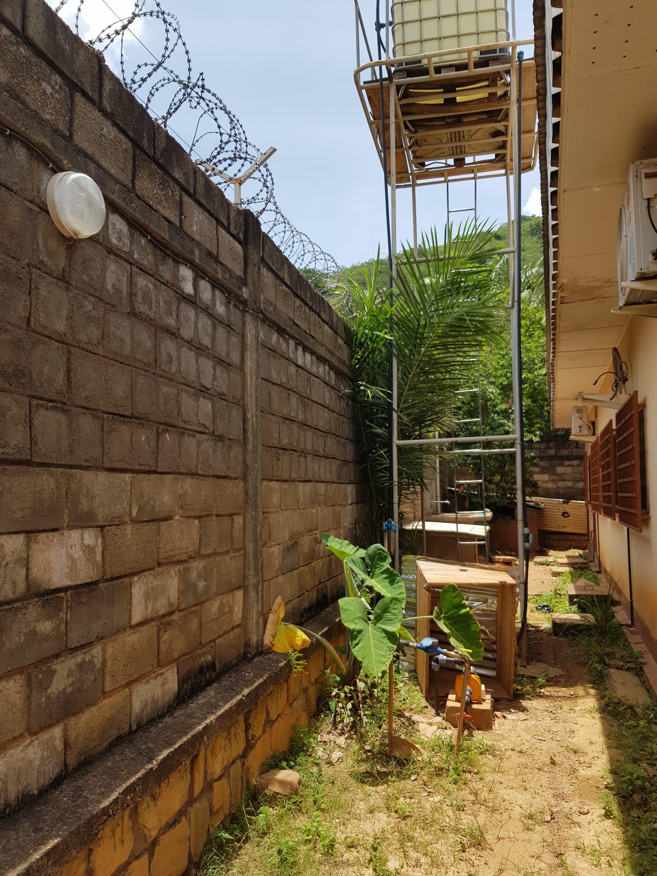
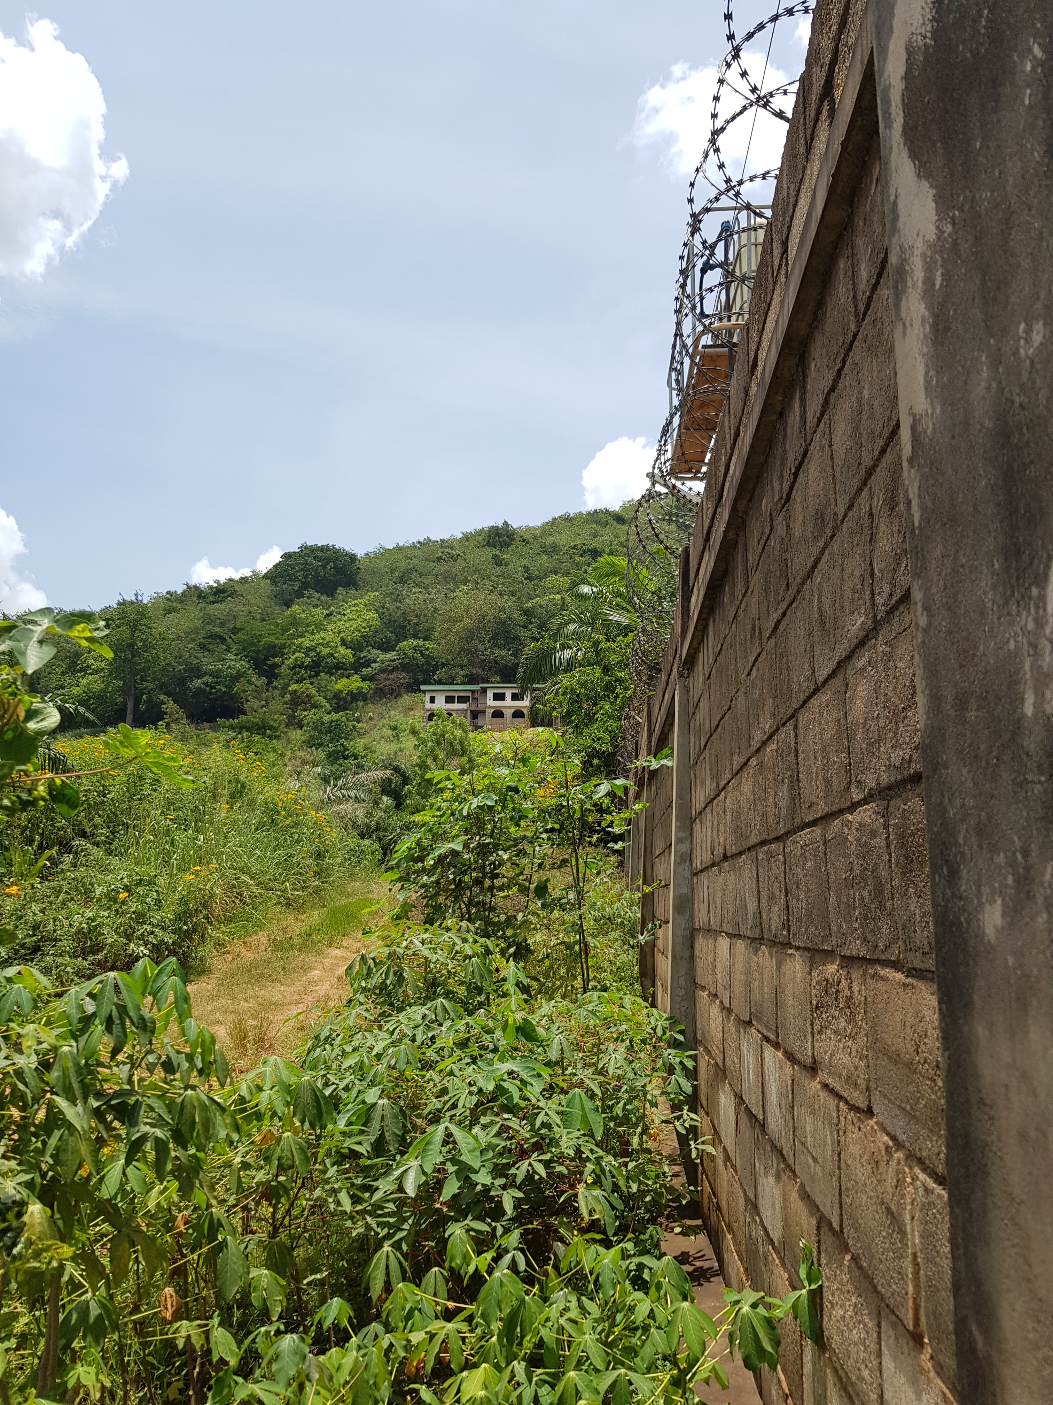
Field Office Exercise

Slide 7
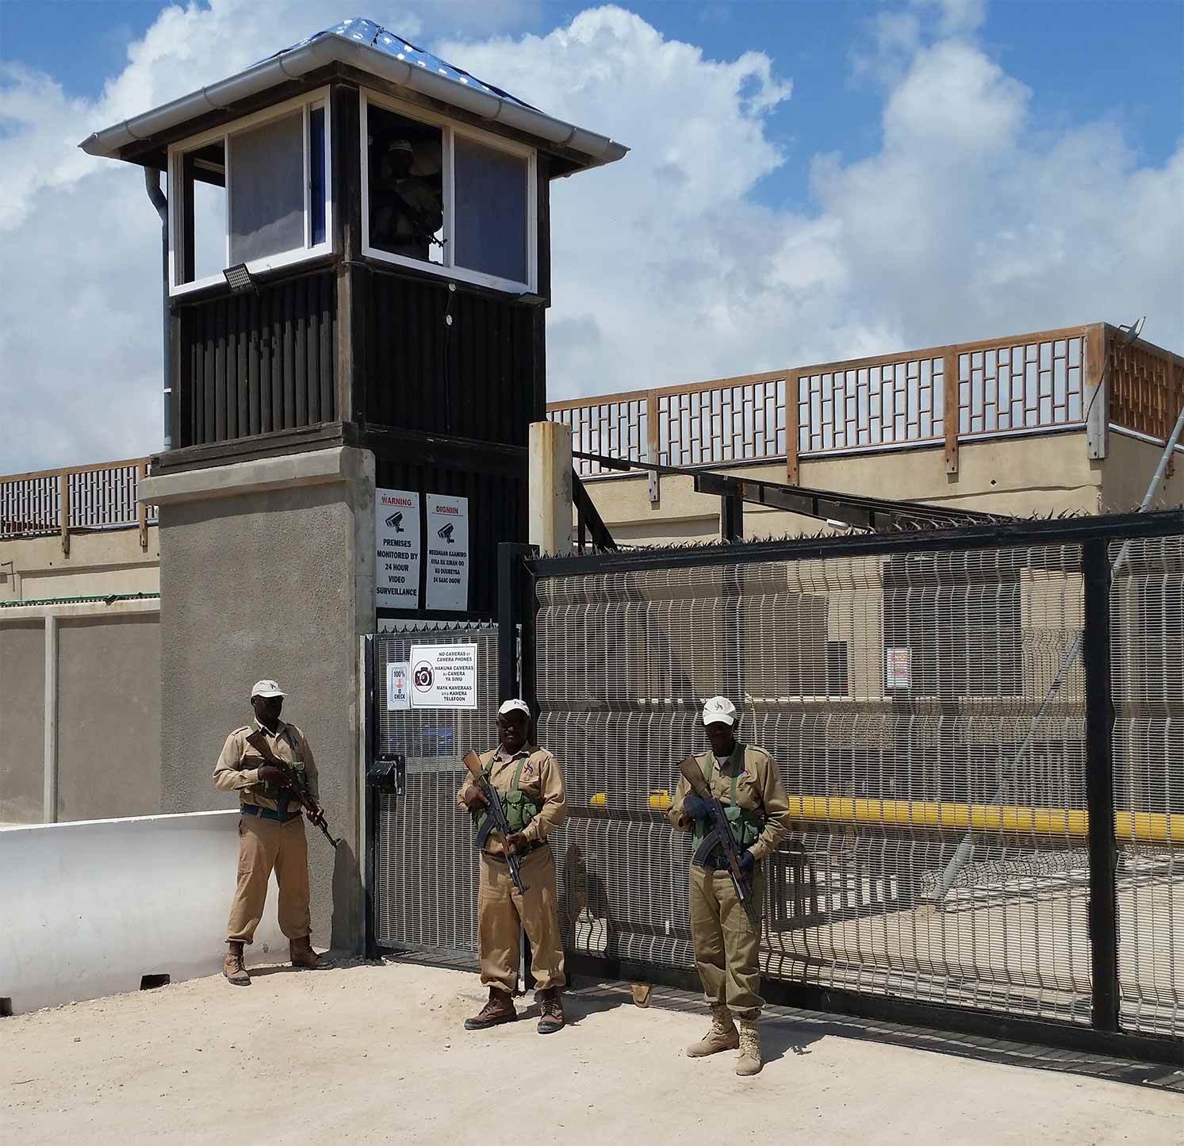
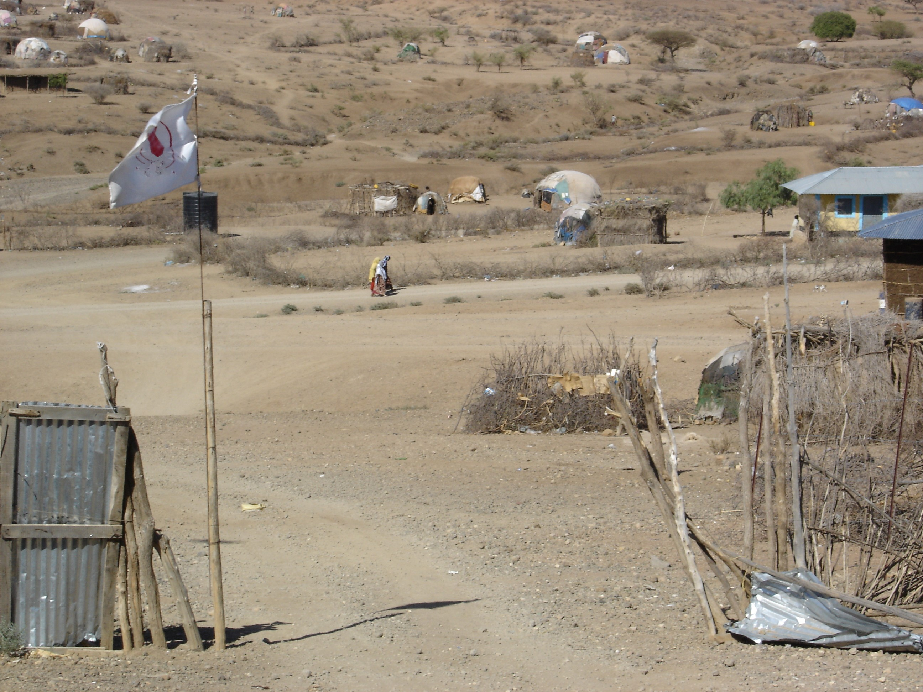
Image & Acceptance

Slide 8
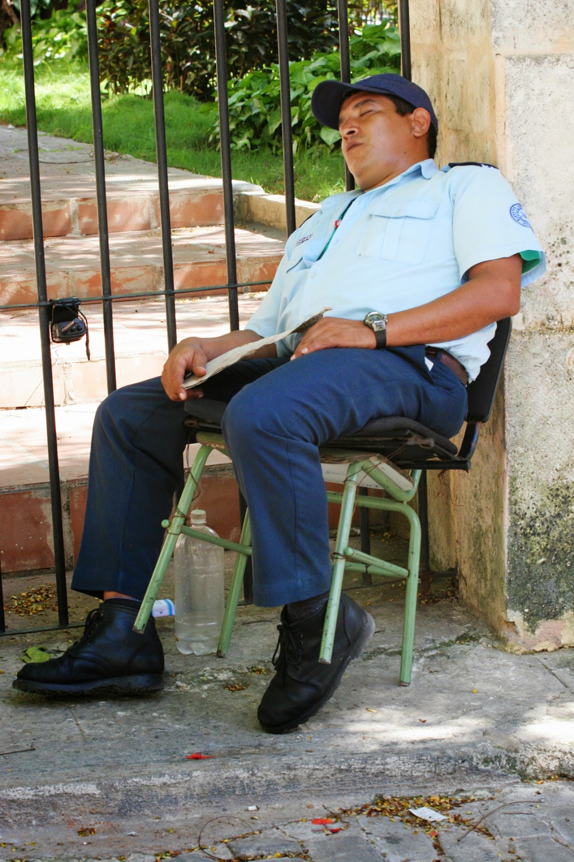
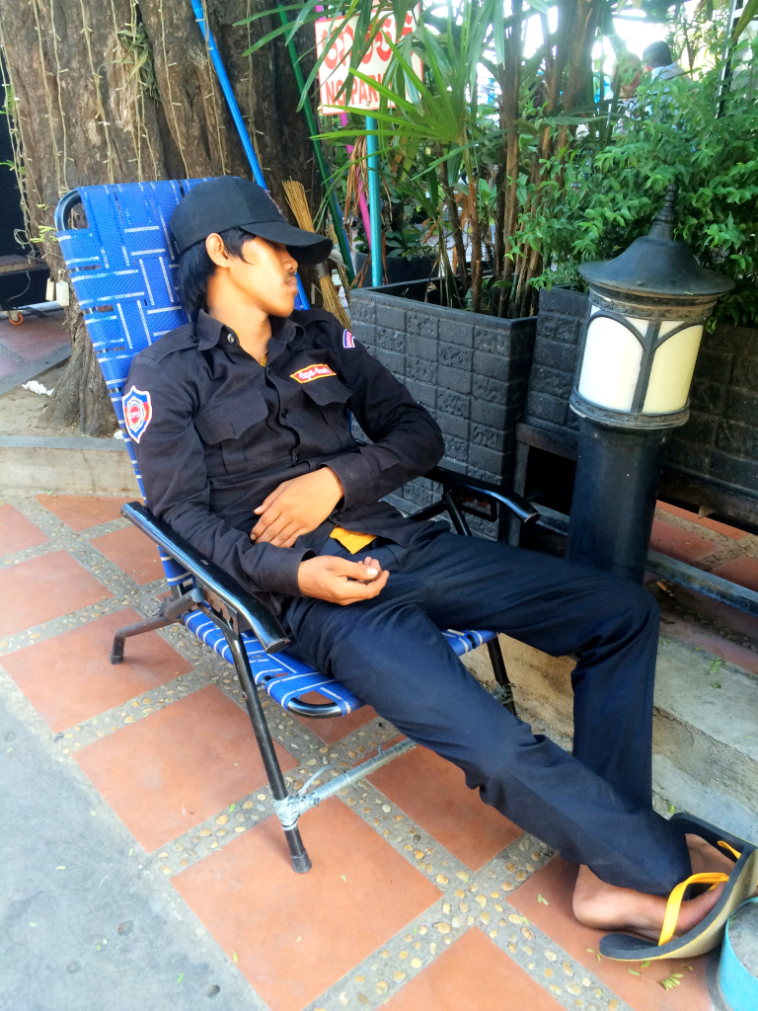
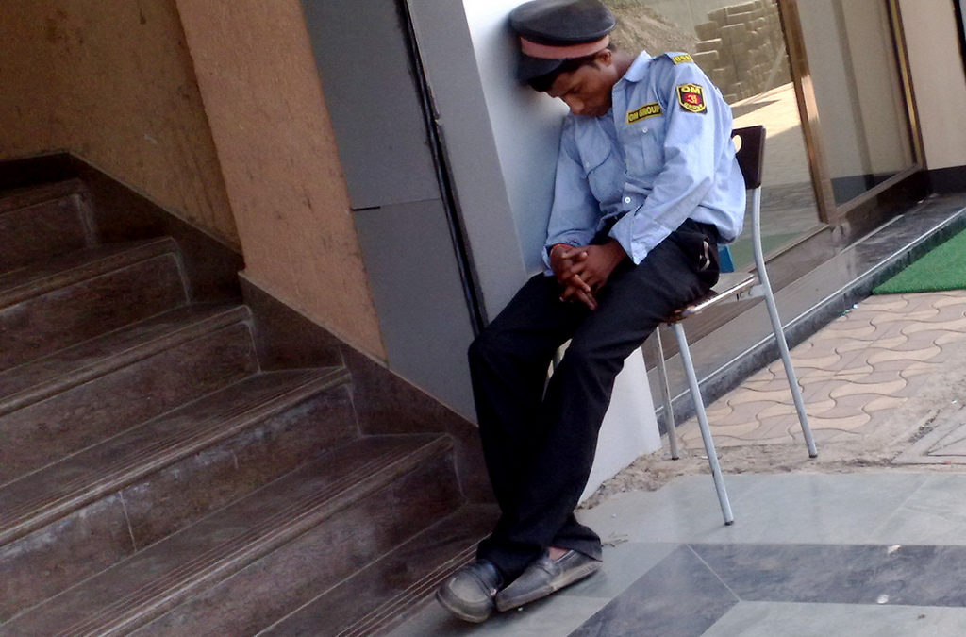
Managing Guards
A sleeping guard is a badly managed guard!

Slide 9
Guard Choice

Slide 10
Guard Management
Guard selection - invest time in selecting the right guards. Check background and seek reliable references, even if guards are from private security company.
Role – provide clear instructions on their duties and how they will be supervised, and what to do and who to inform in case of incident.
Equipment - be clear about the essential equipment provided, and by whom.
Training - ensure guards are trained to deal with the different types of visitors.
Checks - random checks should be made to ensure guards are awake and regularly patrolling the property.
Response - be clear on how guards should respond to suspicious activity, robbery/theft, fire or other incidents that likely to occur in the environment.

