Slide 1
Social Listening
Anahi Ayala Iacucci

Slide 2
What is Social Listening?
It is the process of monitoring and analysing conversations to inform strategic activities both online and offline.
It is a way to make sense of big data
It is a way to identify and explore conversations and communities
It is a way to monitor social media channels to look at how people talk about a certain topic
It is a way to get better understanding of what your audience wants from you
It is a component of risk communication and engagement strategies
It is used to define the regular and systematic aggregation, filtering and monitoring of conversations and public discourse in a combination of traditional media, digital media, off-line and on-line sources of information that represent different populations and geographies.

Slide 3
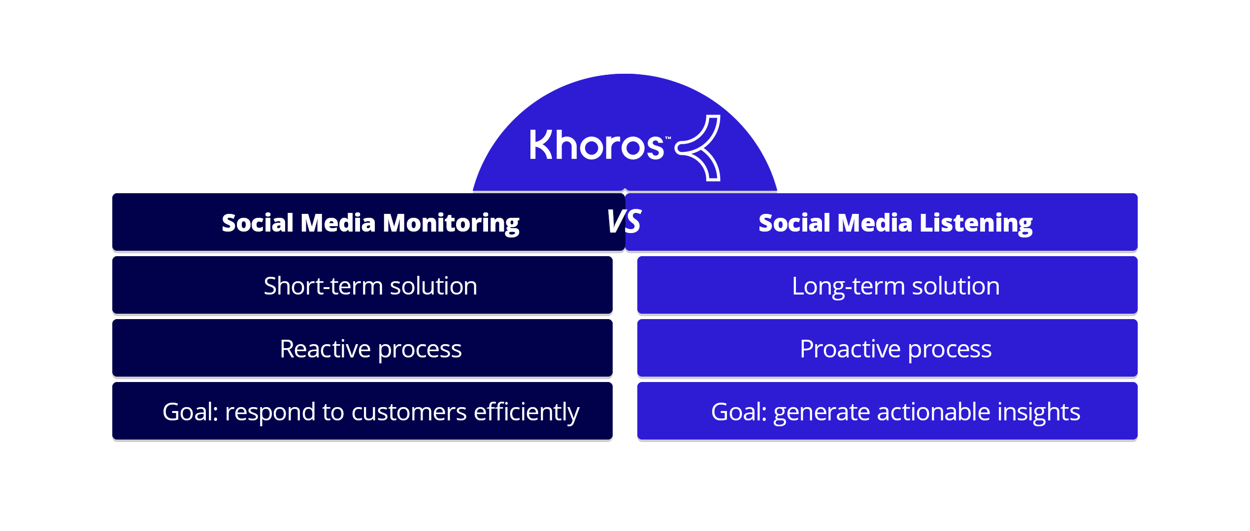

Slide 4
But before you start your actual social listening…
Do a proper desk review:
Are there any incidents/past event that indicate the capacity and the technical background of the different actors in country?
What is the governance structure in country? Who controls what?
Who has access to what part of the pipeline?
What is the regulatory framework in the country?

Slide 5
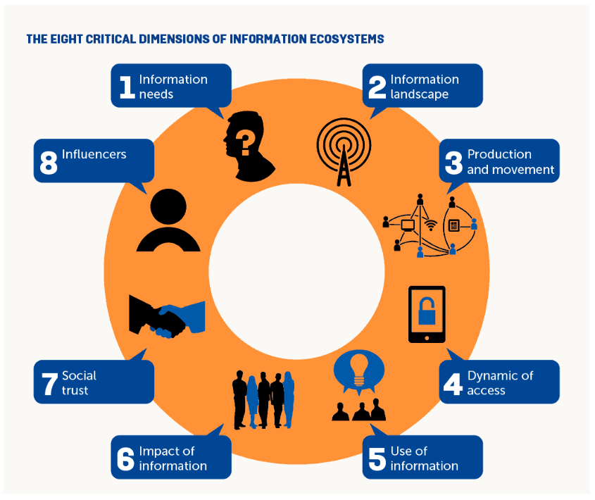
Information Ecosystem Analysis

Slide 6
Social Listening and Risk Management

Slide 7
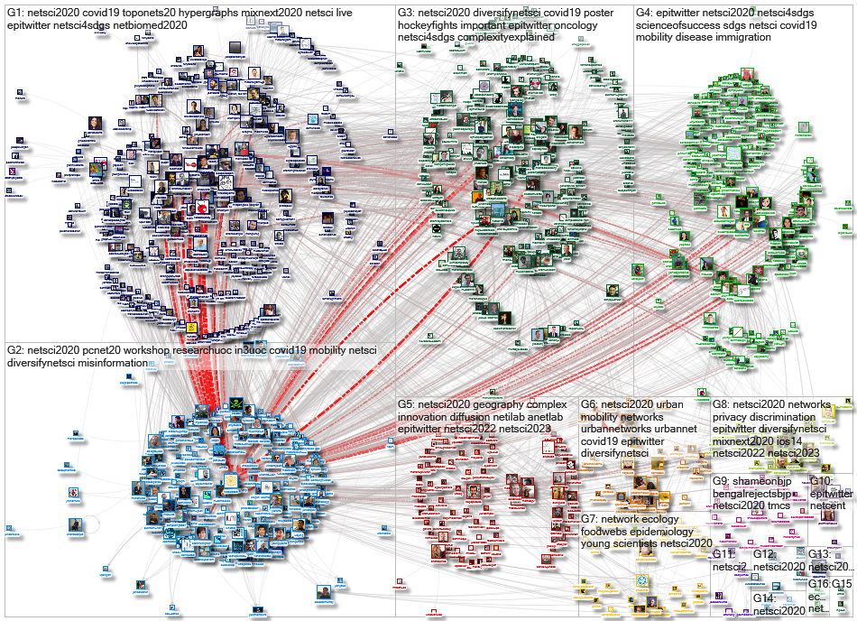
Relationship analysis

Slide 8
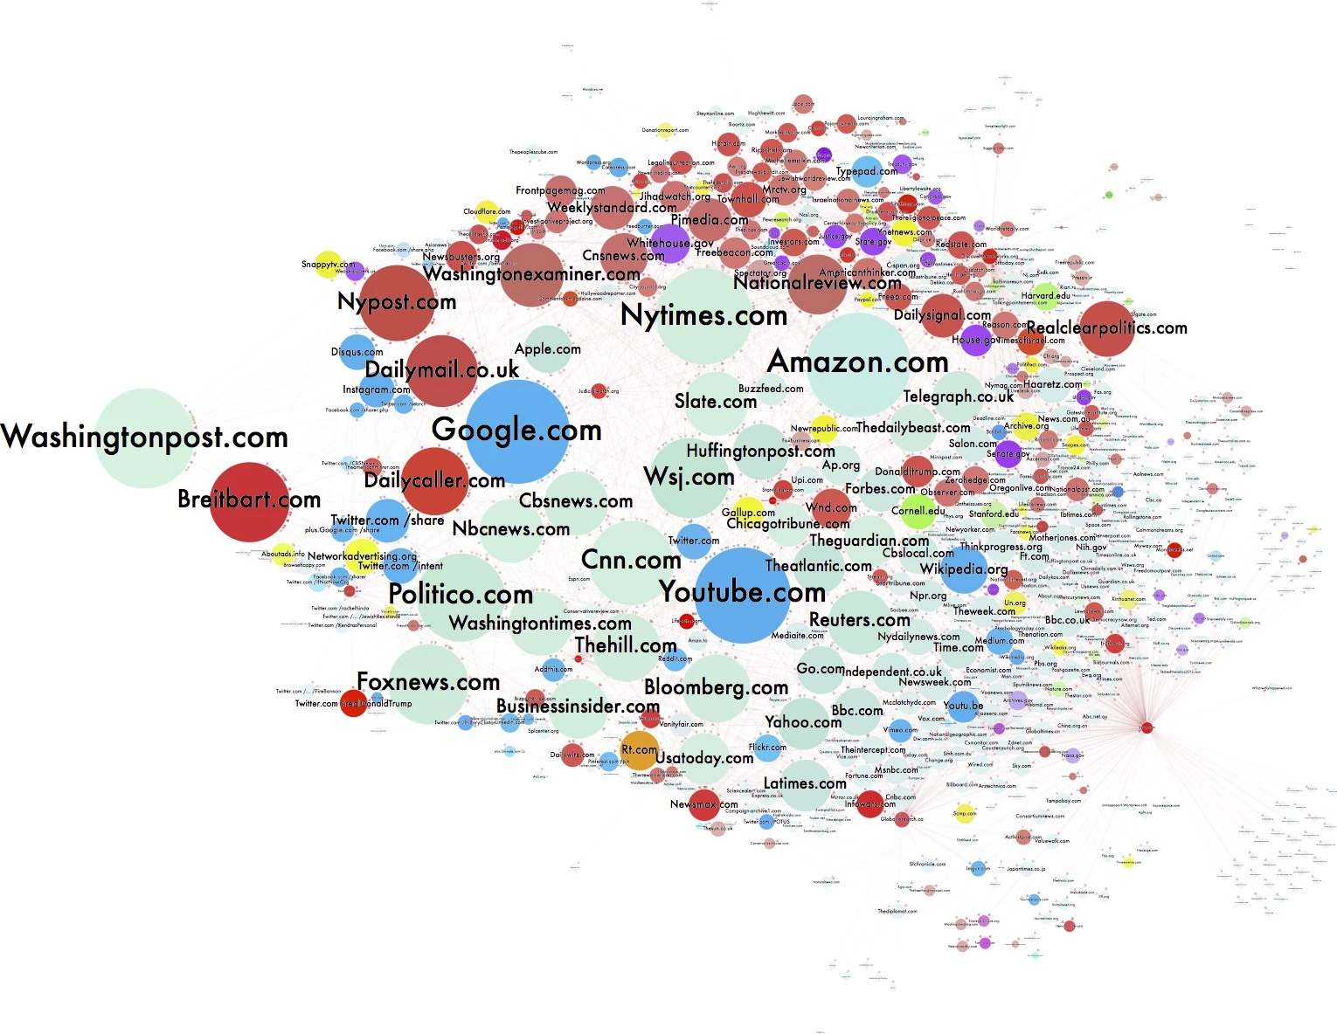
“Theme” Ecosystem analysis

Slide 9
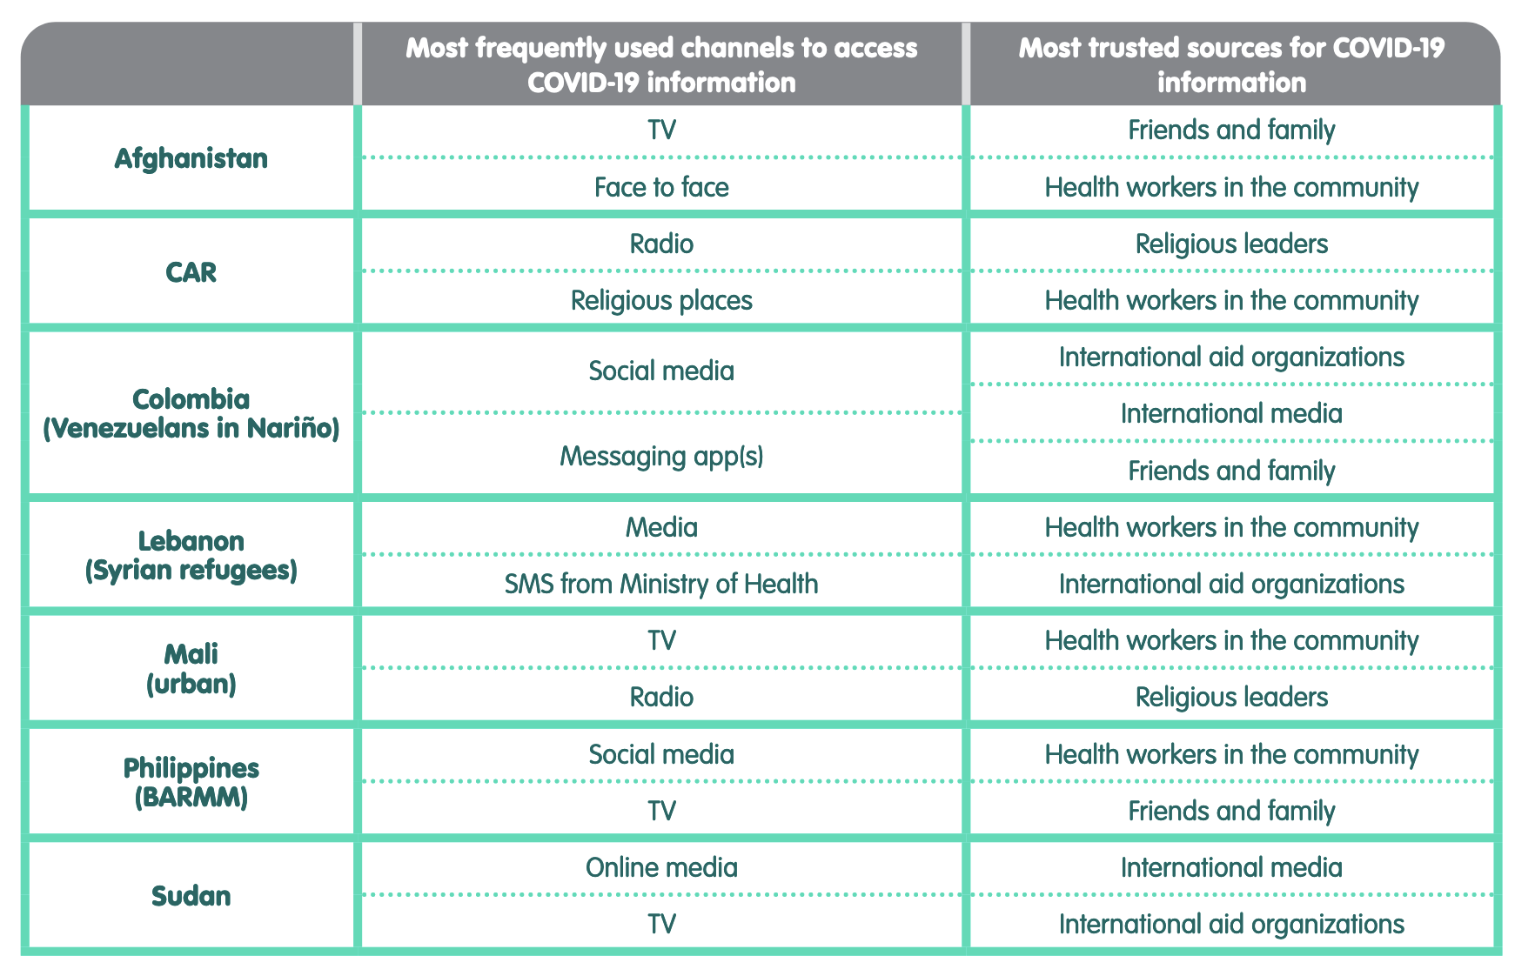
Trust Analysis

Slide 10
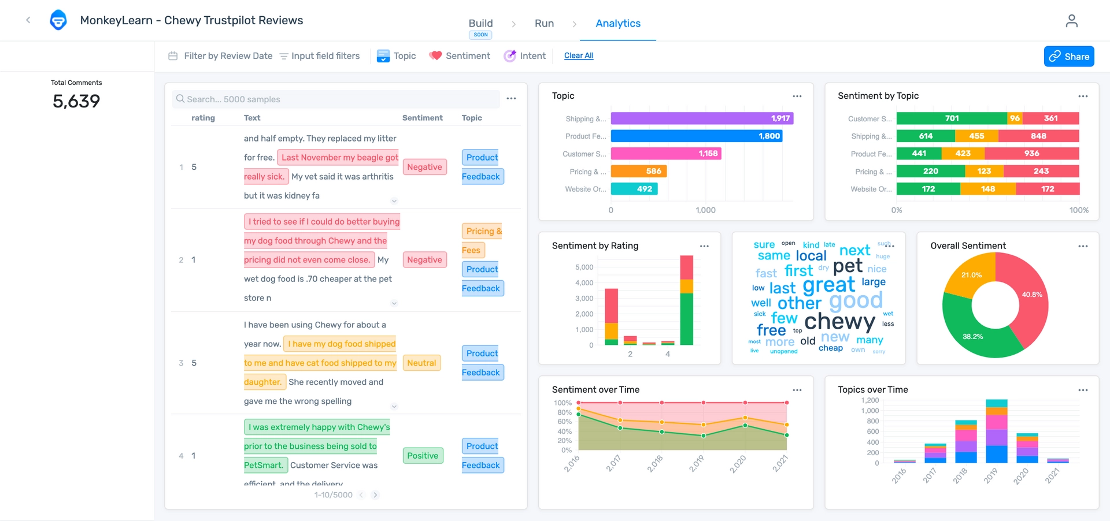
Sentiment Analysis

Slide 11
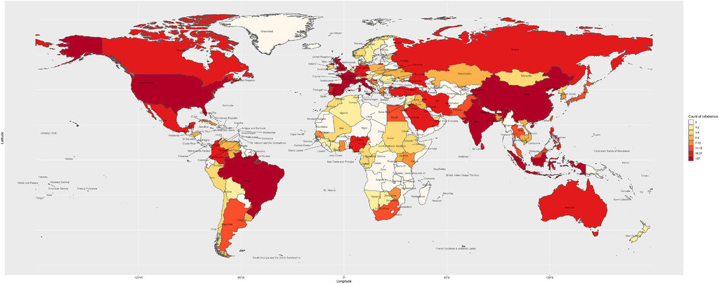
Geographical analysis
Notes:
Distribution of rumours, stigma, and conspiracy theories related to COVID-19 identified during the study, 2020.

Slide 12
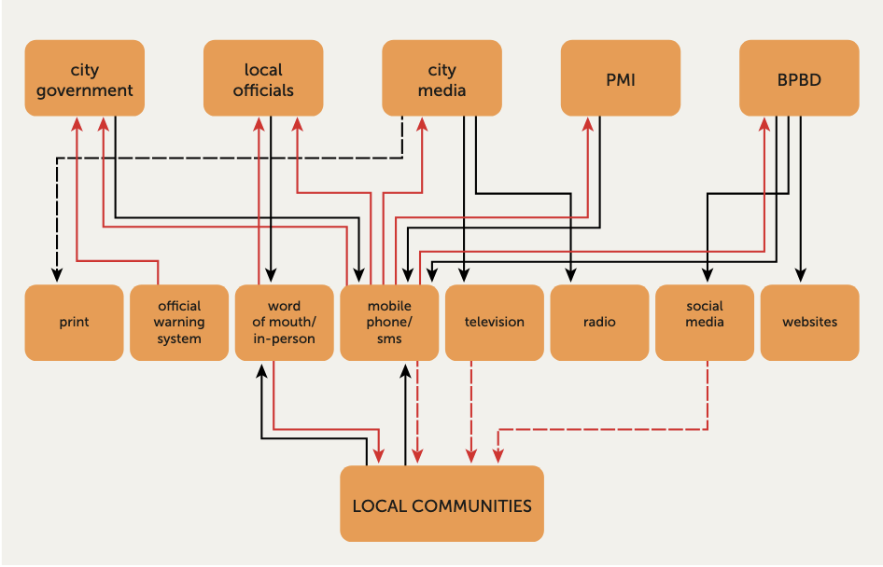
Information flow analysis

Slide 13
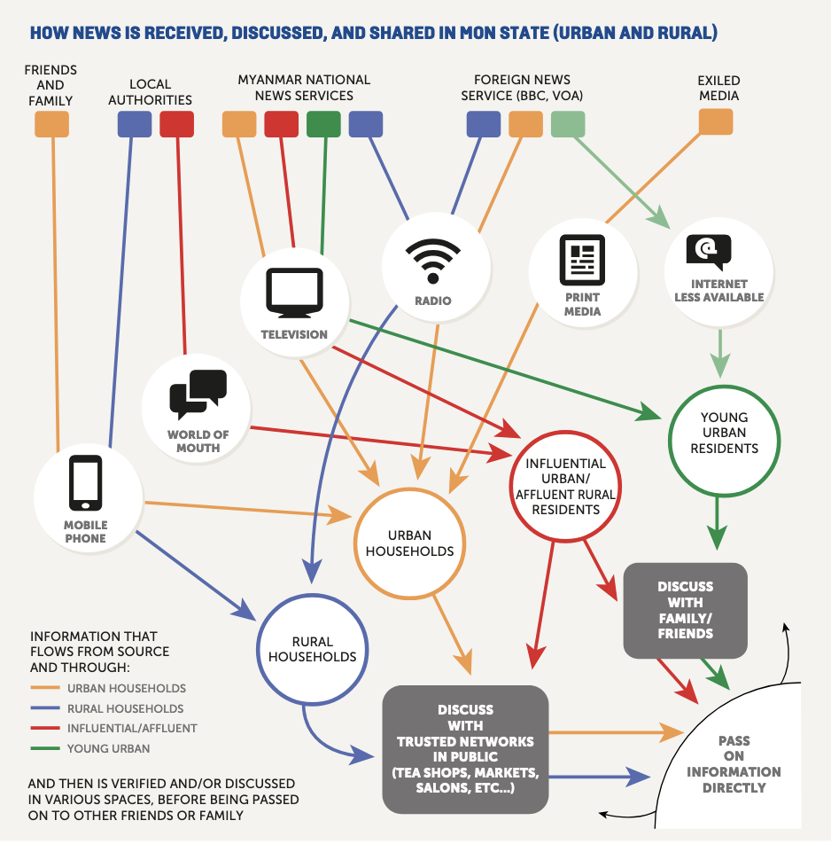
Models for prediction

Slide 14
Group Work

Slide 15
Break

Slide 16
Disinformation Simulation Exercise

Slide 17
Setting the scene
  Analyse the information environment -what social media channels are people on? Who are the influential people? What is the MoH saying about their campaign?
Rumours and misinformation around vaccines have been swirling around. People are talking about their worries as to whether the vaccine is safe and whether they can trust the doctors providing it.

Slide 18
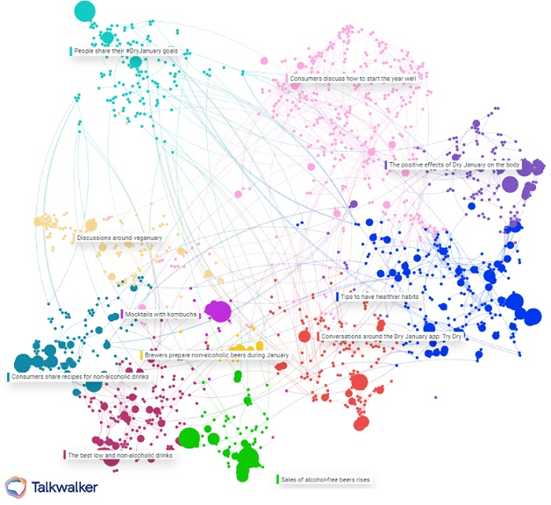
What would you do?
Consider a pre-emptive comms push to explain the benefits of the vaccine and how it provides protection against disease.
Which are the nodes influencing the direction of the conversation? (Offline and online)
How can you reach the maximum amount of people with minimum resources?

Slide 19
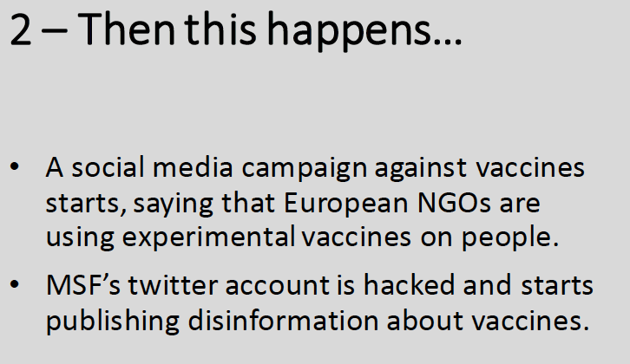
Back to your desk review: who has the capacity to do this?
Who is benefitting from the rumours?
Who are the rumours targeting?
What are the triggers used?
Who are the loudest people?
Who are the trusted people?
Who are your allies?
Notes:
Digital risk? A disinfo campaign against NGOs
Evaluate the reach and virality of the social media posts.
Identify the origin of the post – reverse image search.
Social media monitoring on all channels using key words.
Build a case to ask Facebook to take the post down “imminent threat.”
Consider clarification on social media.
Contact Twitter regarding hack of account – get it closed down.
This has potential Operational and Security consequences, consider
the following:
Consultation with local MoH and community to see if post has had any effect and to gauge the mood.
Contacting those who posted this content.
Update the online campaign – debunk specific myths.
Brief staff and vaccination workers.
Consider delaying the campaign if looks to be gaining traction?

Slide 20
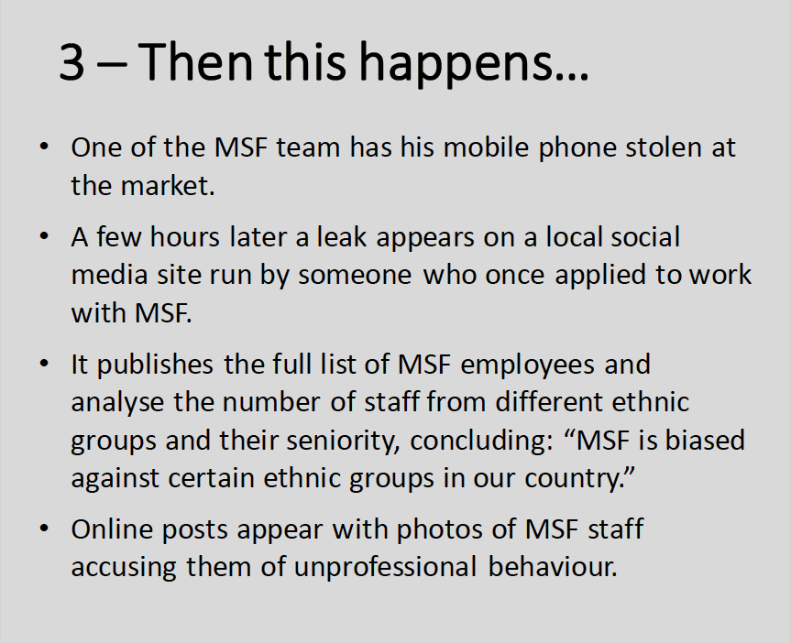
On the social listening side:
* Who are the local trusted media?
* Who can speak for you?
* How can you avoid the defensive position?
* Remove yourself from the conversation? Or not?
Notes:
Digital Risk? Malinformation, Data breach, Disinformation campaign
Manage the online situation:
Immediately report to Twitter to have the account disabled.
Issue a public notification on other MSF channels that this is a hack.
Go on local news platform to inform the public about the hack.
Issue a ‘debunk’ about mask-wearing on social media
Try and identify source of the hack and motive.
Identify security and operational threats ‘in real life’:
Check in with the affected staff member – develop a plan in case she is harassed in town.
Inform staff in the mission and HQ.
Notify all relevant interlocutors: Authorities; MoH; other health actors (UN etc.) that this is a hack and that the information is false.
Advocacy and engagement with community leaders.
Consider suspending the vaccination campaign.

Slide 21
How to use Social Listening to mitigate security risks

Slide 22
Direction: offline to online and vice-versa
International Media and Social Media coverage of the Ebola Outbreak (TV and Social Media)
Liberian Diaspora in the USA (TV and Social Media)
Liberian Population in Liberia (Telephone & Messaging Apps)
Liberian Population offline
Liberian population online
Inter-ethnic attacks on the ground (offline)
South Sudanese population (offline)
South Sudanese population to South Sudanese Diaspora (Messaging Apps and Social Media)
South Sudanese Diaspora online
South Sudanese Population online and offline

Slide 23
Maximize resources, decrease response time
Once you have identified the direction of your information, target important nodes only→ this is important offline and online.
Once you have identified your network, you can use it to speak for you.
Once identified your information flows, you can prevent the spread by targeting the next step on the flow.

Slide 24
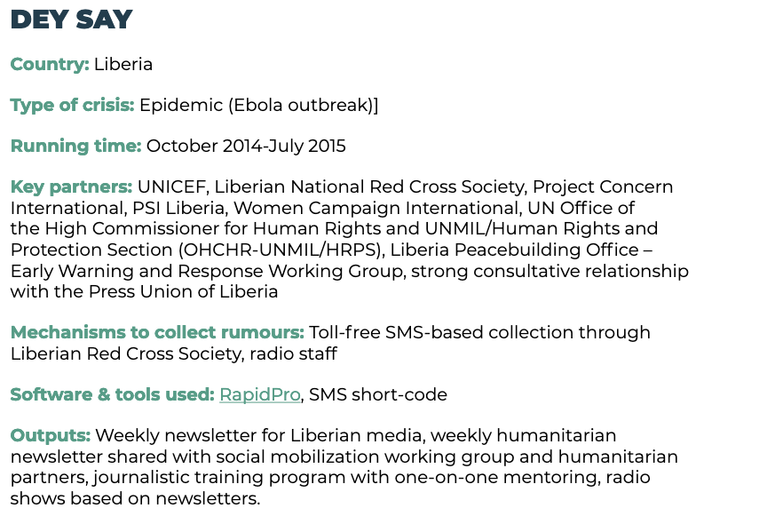

Slide 25
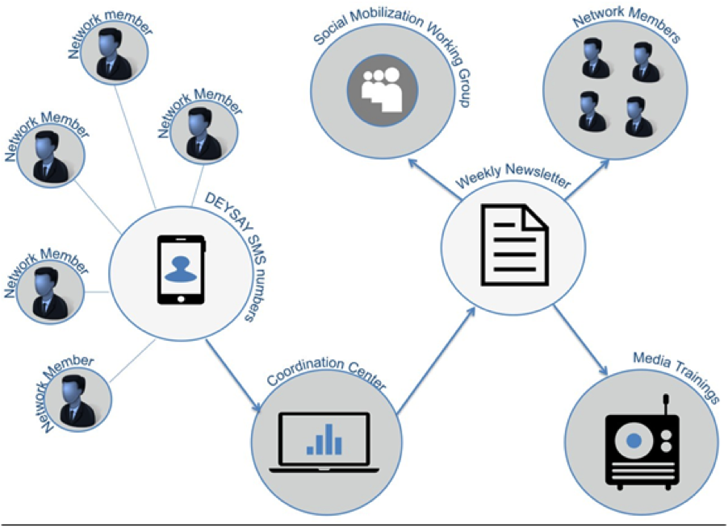

Slide 26
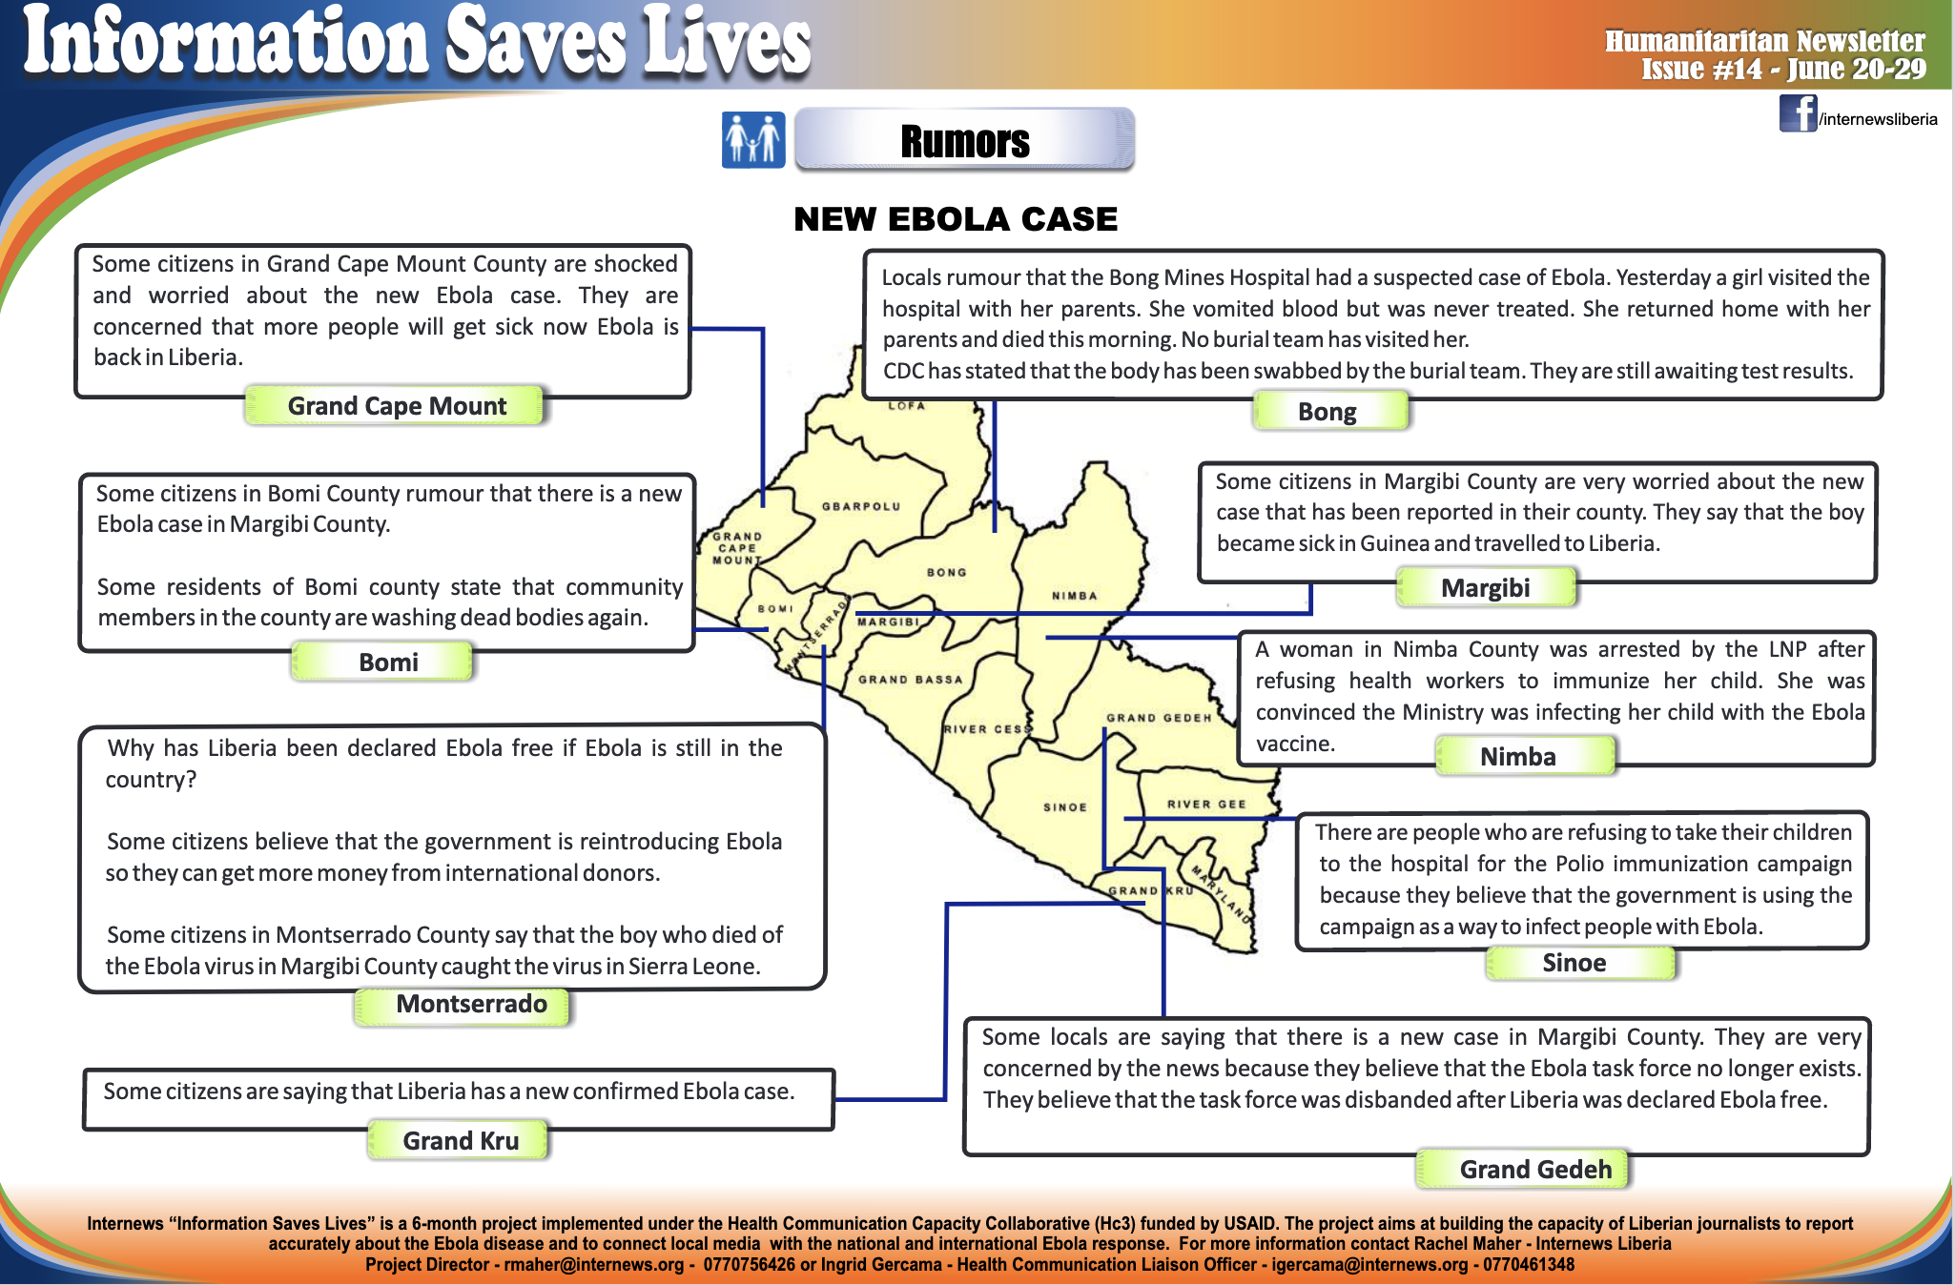

Slide 27
Maximize effectiveness of your counter-campaign
Remember that people spread misinformation/disinformation:
To explain a situation or an event
To share useful or entertaining information
To define oneself by being ‘in the know’ or making others look bad
To develop relationships by using information as a currency
To feel connected to issues affecting them
To mislead or deceive: often economically or politically motivated.
With the exception of disinformation, people generally share rumours because they believe the rumour or parts of the rumour.
Understand what people are looking for/what is missing for the mis/dis info to be able to spread

Slide 28
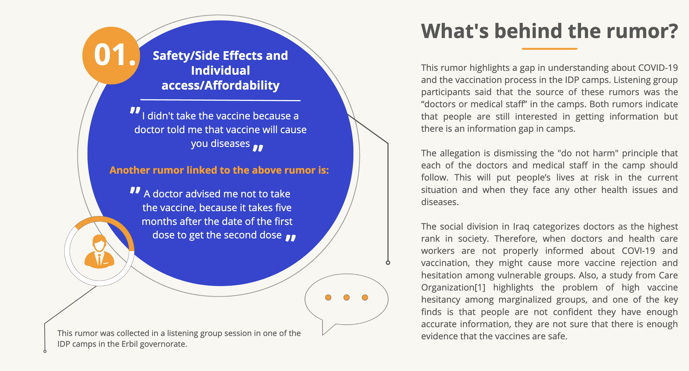
Covid 19 Response

Slide 29
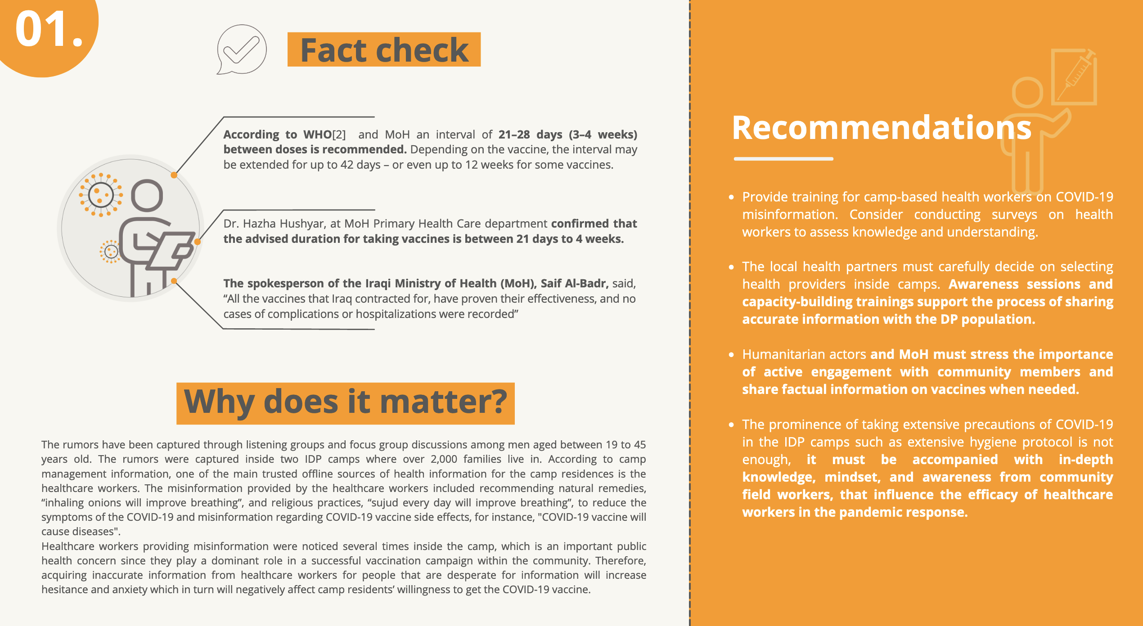

Slide 30
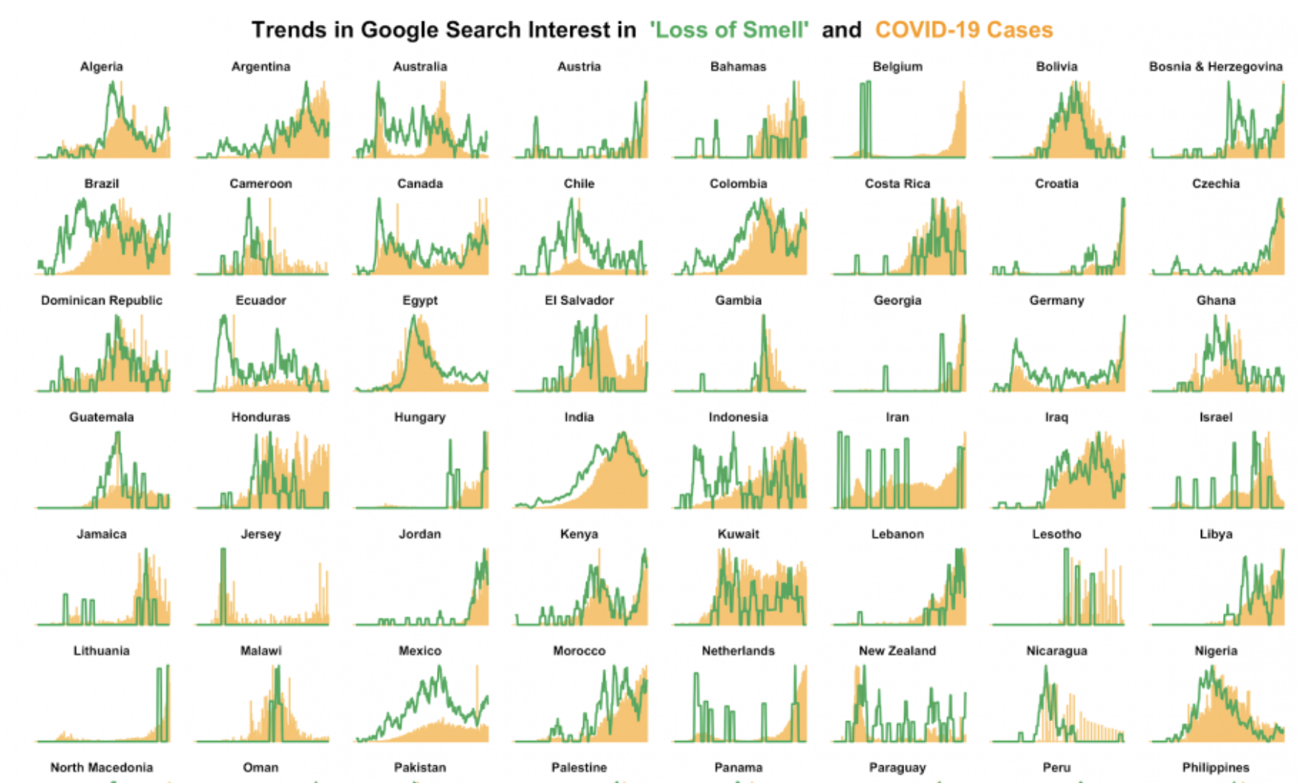
Patterns and spikes

Slide 31
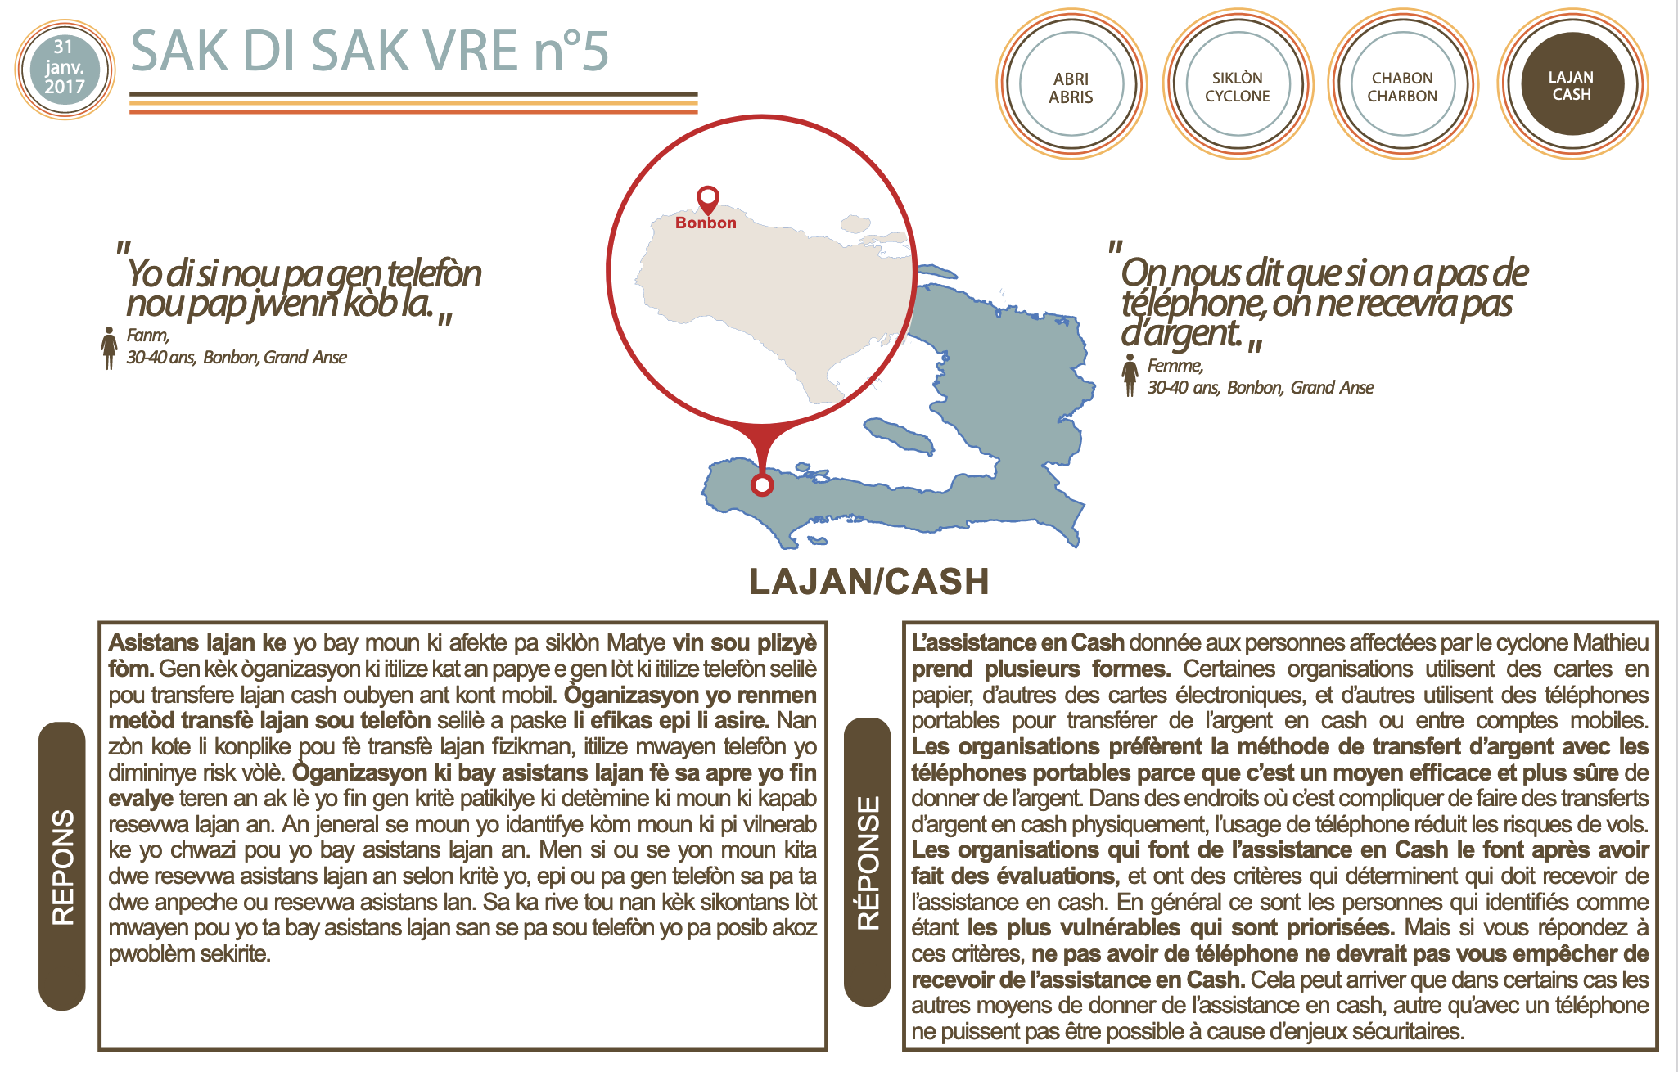
Offline component: Working with local media

Slide 32

STRATEGY 1: Preventive misinformation debunking
Use models to predict where the rumors will next appear or who will most likely pick it up
1
Identify how and and how fast the rumors will spread
2
Identify the target population of the rumors
3
Identify key nodes in the spread of the rumor
4

Slide 33
STRATEGY 2: Full Ecosystem response
Identify all the channels available and used by the local community targeted
Create specific content – interactive and multimedia to provide information about the issues emerging from the rumors
Engage unconventional actors to have “spokesperson” that can speak on your behalf
Allow people to talk to you directly

Slide 34
How about long-term solutions?

Slide 35
Social and Behavioural Change Communication
Social and behaviour change (SBC) communication aims to empower individuals and communities, and lower structural barriers that hinder people from adopting positive practices and societies from becoming more equitable, inclusive, cohesive and peaceful.
Drawing on various disciplines (from sociology and psychology, to communication and behavioural economics), SBCC encompasses any set of strategies and interventions that influences drivers of change and supports local action towards better societies.
SBCC blends scientific knowledge with community insights, most importantly, to expand people’s control over the decisions that affect their lives.

Slide 36
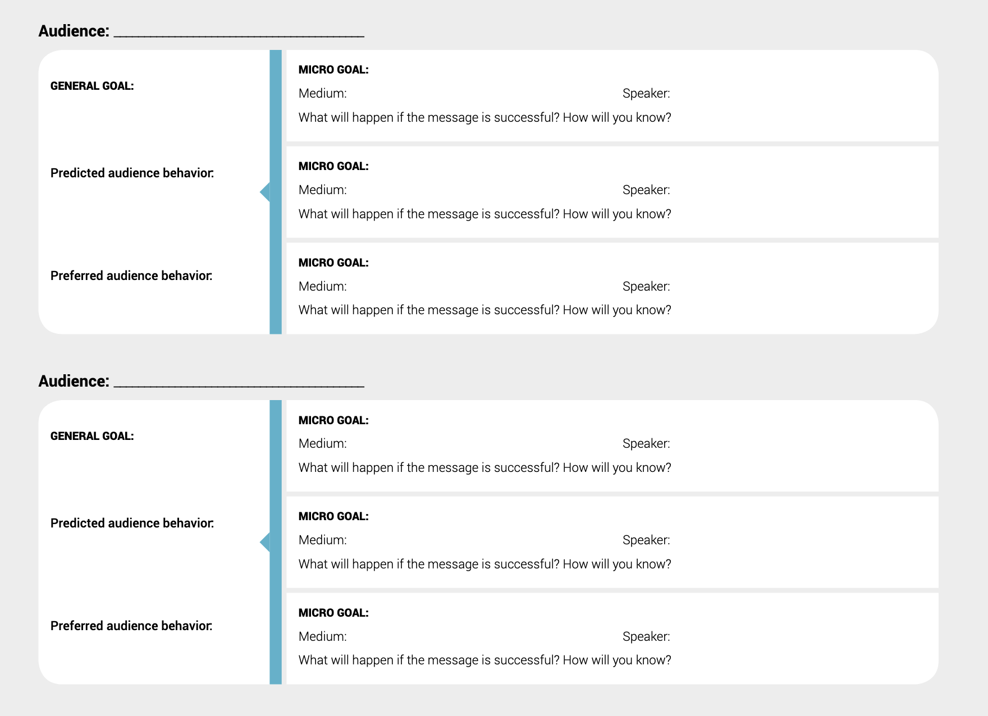
Link your awareness and communication campaigns to specific objectives

Slide 37
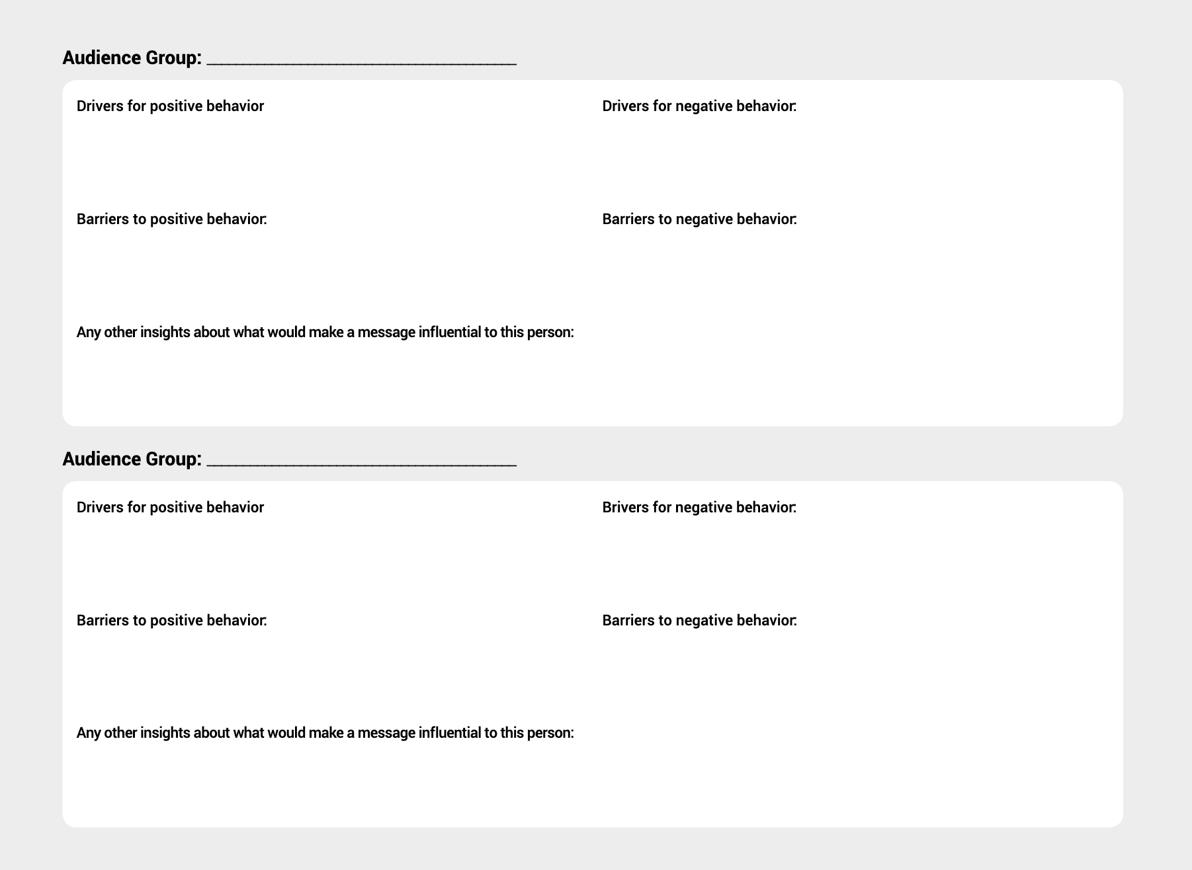
Design targeted content

Slide 38
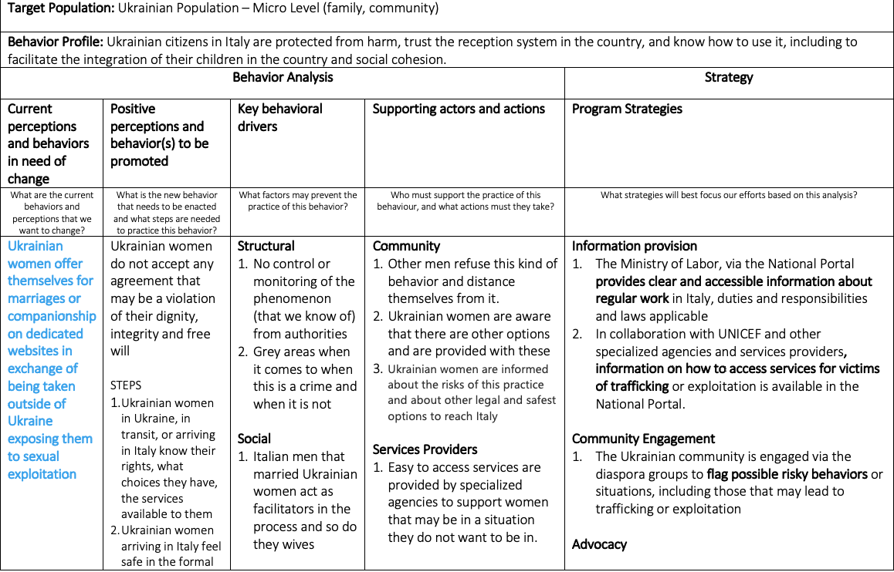
SBCC

Slide 39
Case Studies

Slide 40
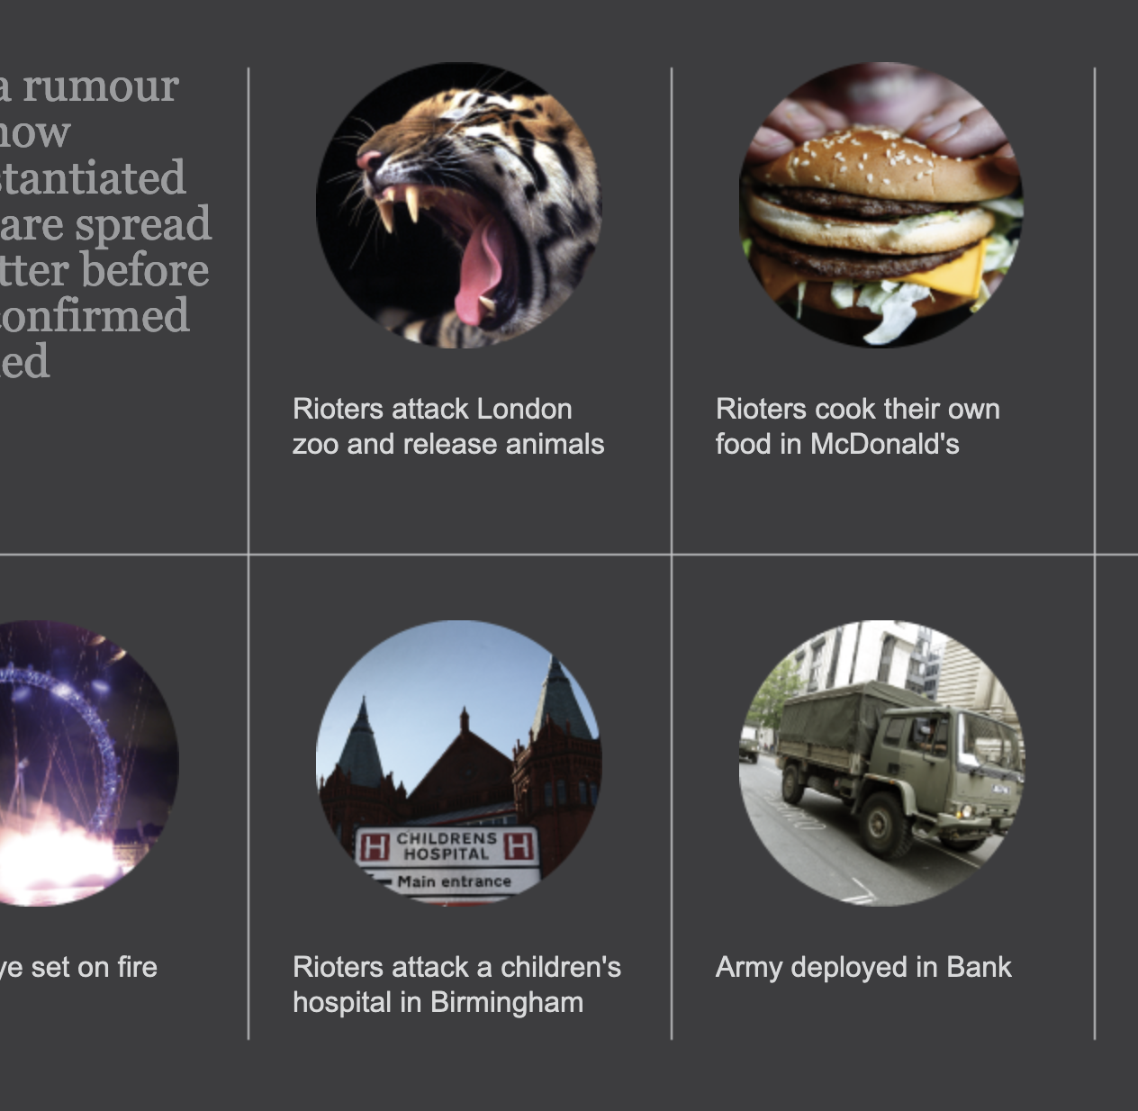
The power of the crowd

Slide 41
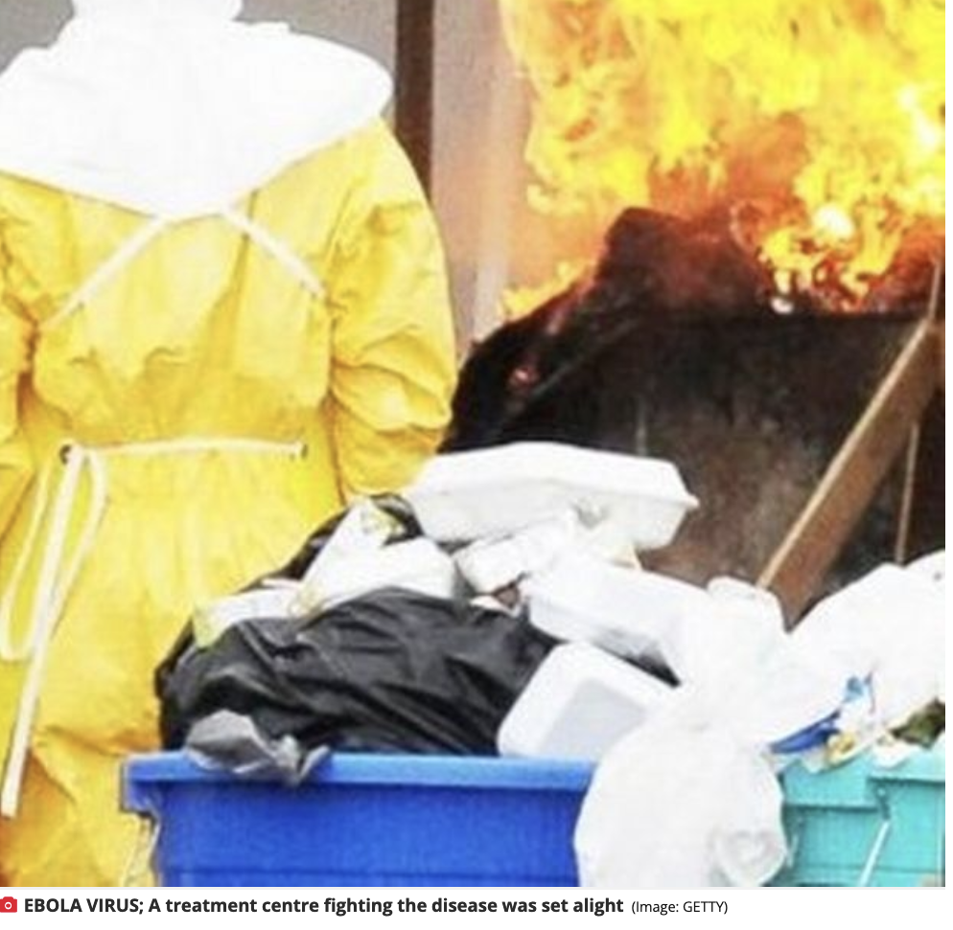
LIBERIA: “Ebola Treatment centres are burning people alive”

Slide 42
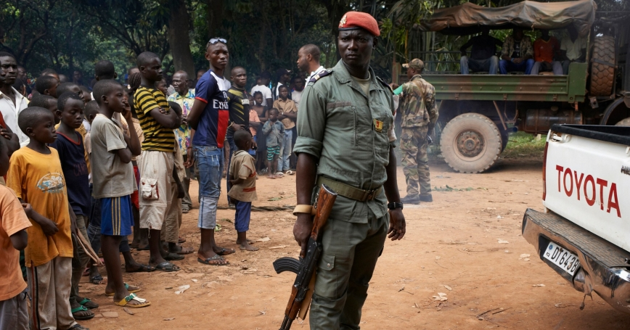
Central African Republic: “They are coming”

Slide 43
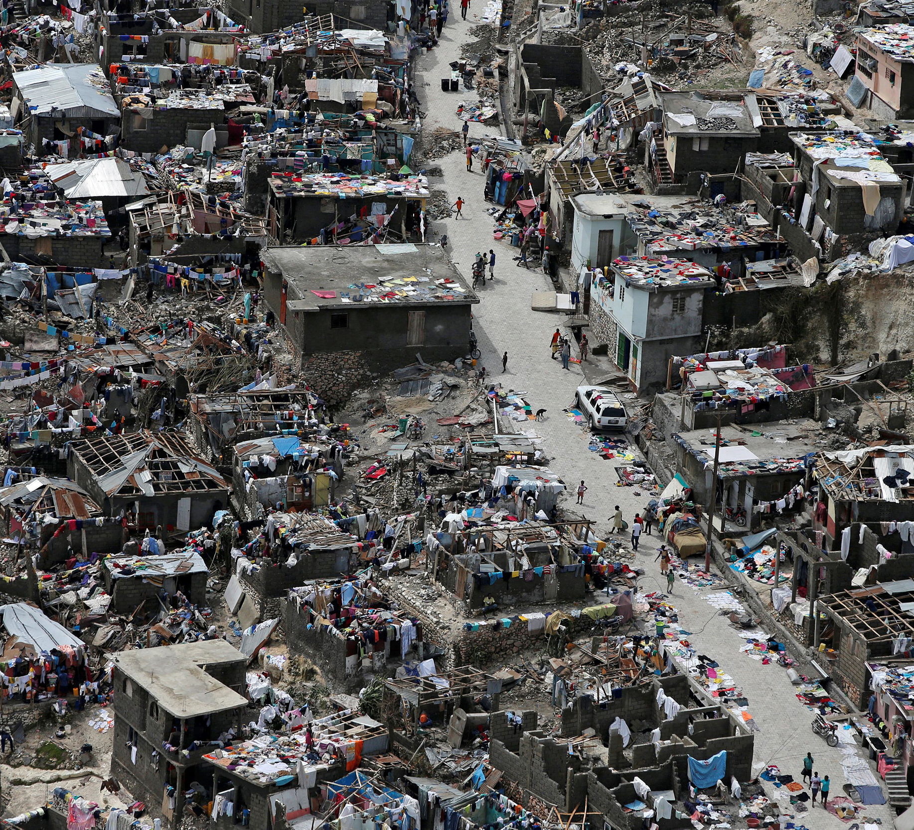
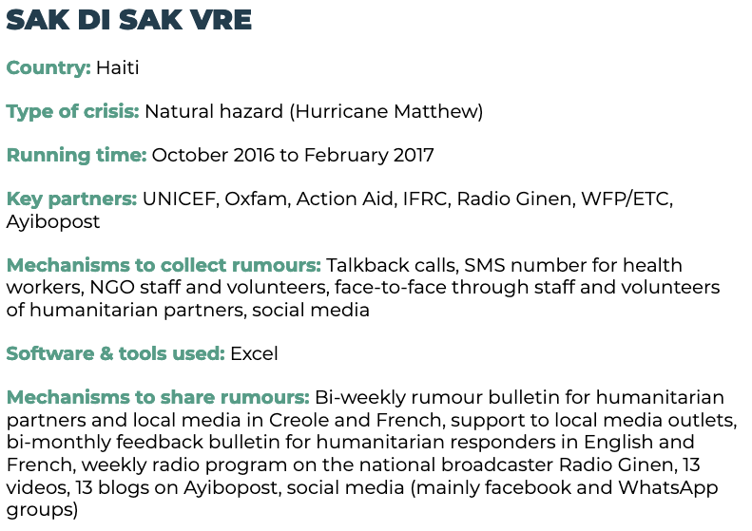

Slide 44
Humanitarian Bulletin
Blogs
Facebook videos and Memes
Facebook Page
WhatsApp Media Channel
Outreach workers
Weekly Radio Programs
SMS number

Slide 45
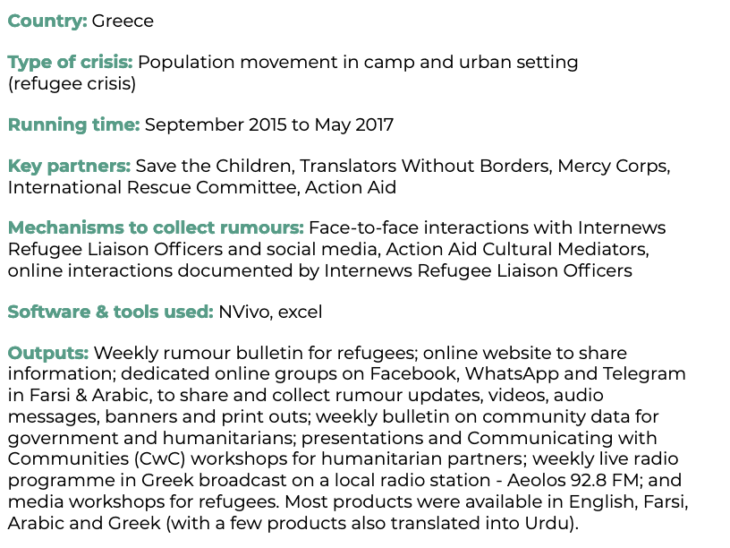
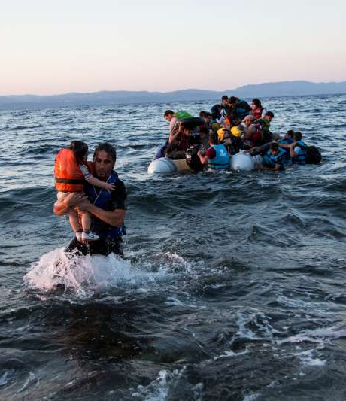
News that Moves

Slide 46
Farsi FB Page
Arabic FB Page
NTM Website
Humanitarian bulletin
Rumors bulletin

Slide 47
2-way Telegram Channel
2-way WhatsApp Channel
Banners and Posters
Face to Face
Radio Programs

Slide 48
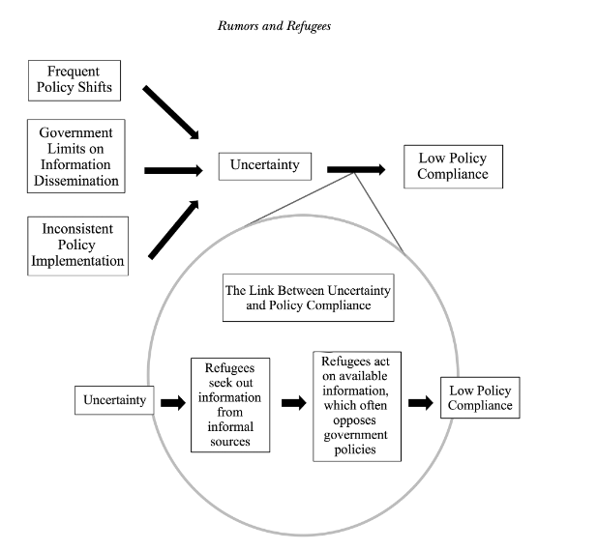
Make sure you know the origin of your problems

Slide 49
What made these projects successful?
Realistic goals and impact objectives
Entirely relying on the community
Customized to the local needs and adaptable
Hired all refugees/migrants/locally resettled refugees
Involved a wide range of actors from NGOs to local orgs
Links between online and offline
Not automated or standardized

Slide 50
Group Work

Slide 51
Thanks
Anahi Ayala Iacucci
anahiayala@gmail.com

