Slide 1
Inclusive Security

Slide 2
Diversity Iceberg

Slide 3
Diversity in Risk
Diverse workforce = Diverse risks
Individuals may face different risks due to their unique profile or identity.
More than just gender or nationality.
Minority profiles – eg staff with disabilities, minority ethnicities or races and those who identify as LGBTQI - are often more at risk of both external and internal threats.

Slide 4
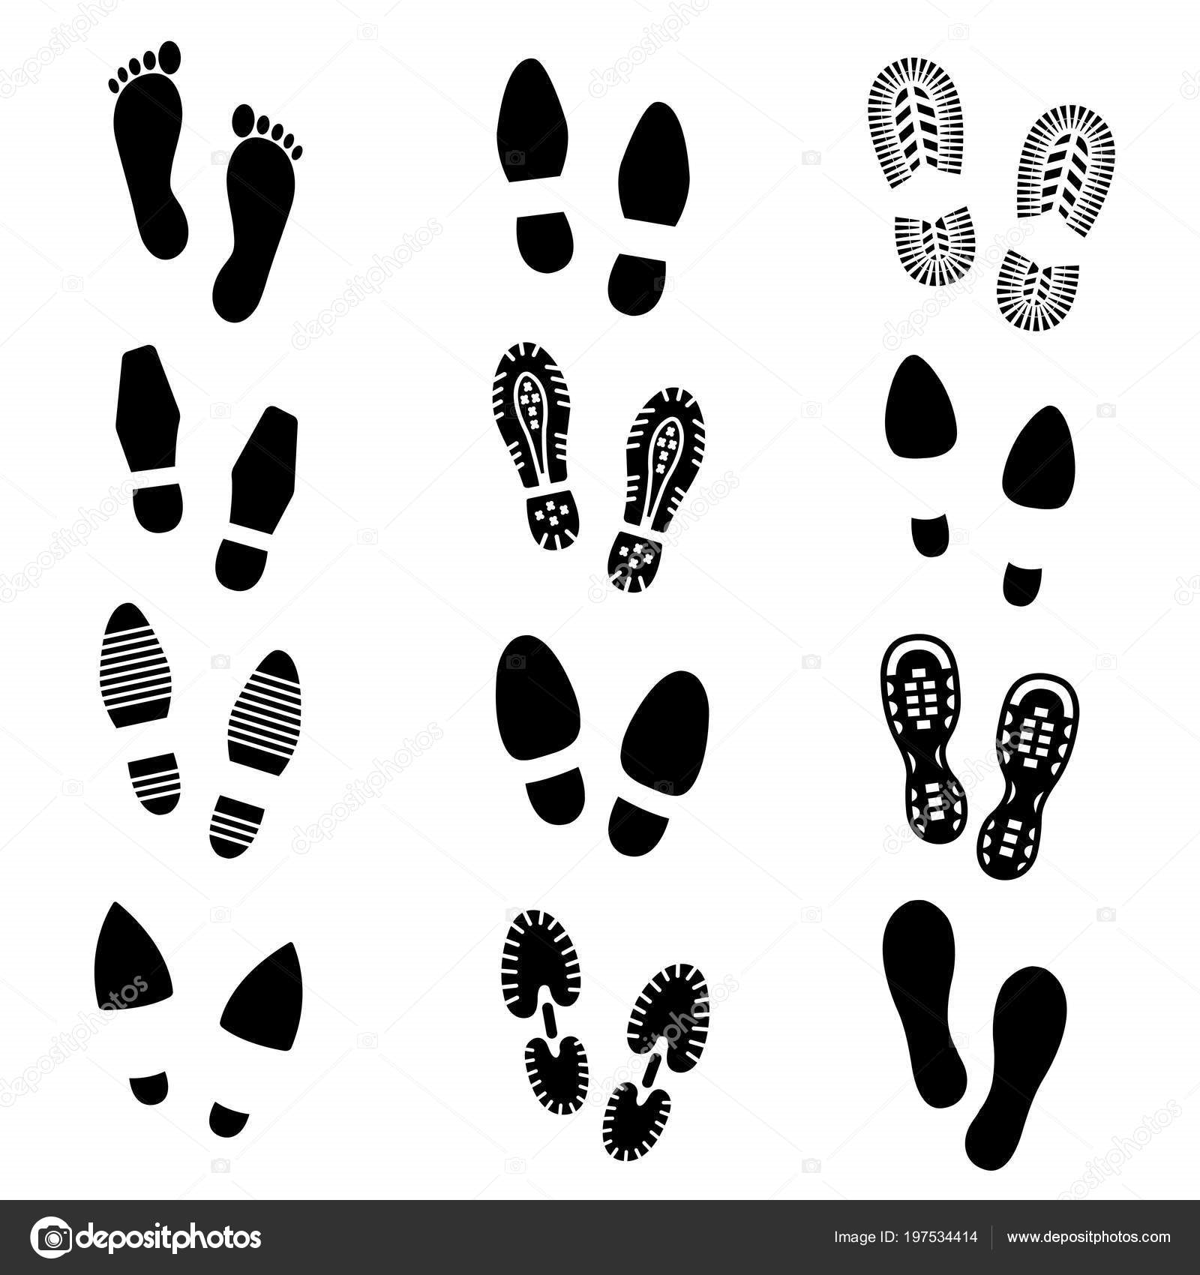
In Someone Else’s Shoes
Walking to work in the morning.
Working late in the office.
Travelling to remote areas of the country.
Staying at a hotel/guest house.
Dealing with security forces on a checkpoint.
Engaging with community leaders.
Addressing complaints & concerns of angry beneficiaries.
Evacuating the office in an emergency.
Meeting colleagues for a drink/meal in the evening.

Slide 5
Definitions
Equality - ensuring individuals or groups are not treated differently or less favourably, because of their specific personal characteristics.
Diversity - the characteristics that make an individual or group different from another. These include race, ethnicity, gender, disability, sexual orientation, religion.
Inclusion - creating a working environment in which any individual or group feels respected, supported & valued.

Slide 6
Inclusive Security
Acknowledge the diversity of staff.
Identify external and internal threats that different staff may face.
Adapt security plans and procedures to meet the diverse range of staff.
Ensure briefings, orientations and trainings address diverse profiles.
Proactively provide guidance and support to all staff to enable them to fully participate and feel protected.

